Slide 2
X-Ray Vision to Boost Sales and Utilization
Kevin Schmitt
Sr. Performance Manager

Slide 3
Agenda
How to identify opportunities in VinSolutions
Better Utilization from your sales staff with 1 on 1’s
How to identify red flags and understand settings in VinSolutions

Slide 4
Can You Find Car Deals Quickly?
Our Reality Day to Day
Hyper Focused on Selling Vehicles.
Wearing many hats in your role.
Babysitting (never happens ever).
“I am too busy” = Performance Management can help with your day..
The Big Picture
There is more around us that helps us sell vehicles then what is in front of us.
Time management.
Stepping out of your business to work on your business.

Slide 5

We Have Emotional Based Roles
We Thrive off Showroom Music.
Opportunities/Appts, Demos, Service Walks.
Salespeople on the phones.
Customers in the showroom.
Salespeople waiting in line at sales desk.
Finance has customers in the box and more in the Shute.

Slide 6
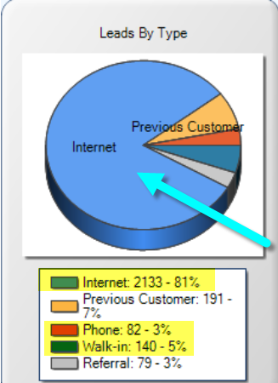
What Does Your Whole Business Look Like?
Where can you focus on opportunities outside of Showroom?
Where are your opportunities to make the most impactful changes?
Are You missing the big Picture?
More to our business then the showroom

Slide 7
How to Identify Opportunities in VinSolutions Quickly!

Slide 8
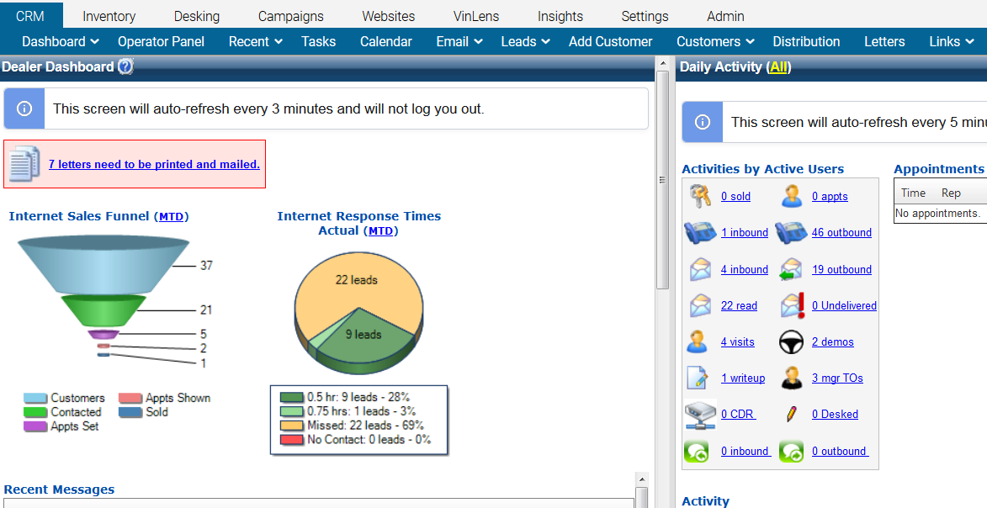
What is SO Special About Inbox?

Slide 9
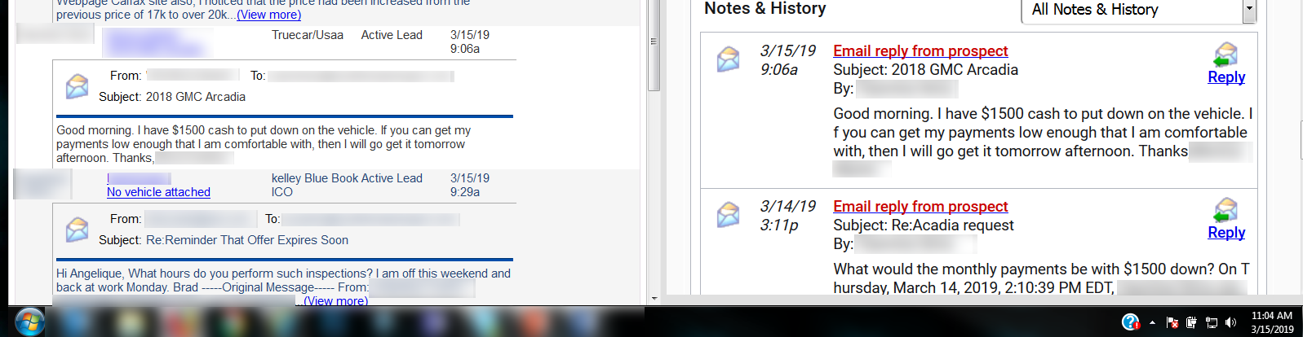
Do You See A Car Deal Here?

Slide 10
See Everything All In One Place

Slide 11
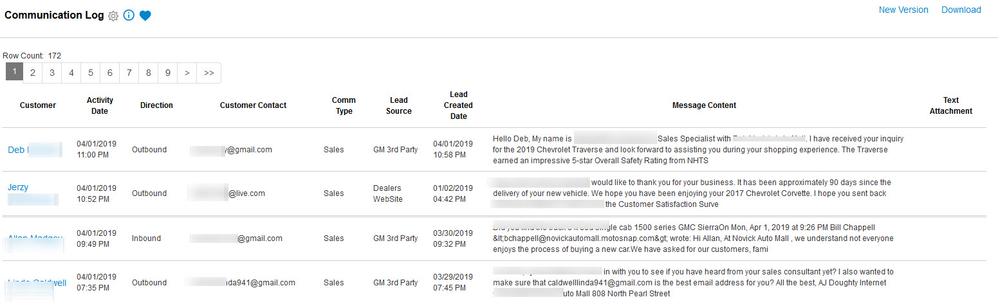
Communication Report

Slide 12
Is it Really LOST?
Not what you think…

Slide 13
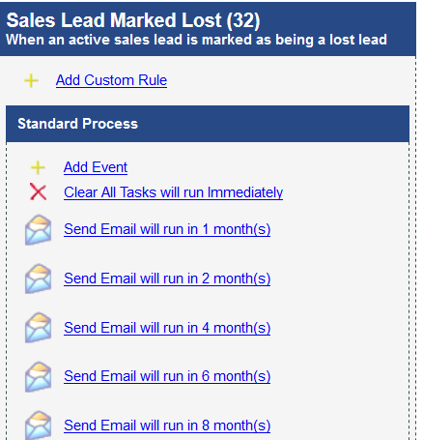
Let the CRM Work For you
What does Lost Really mean?
What does your LOST process look like? Do you understand the importance of it?
What can you make it do for you?

Slide 14
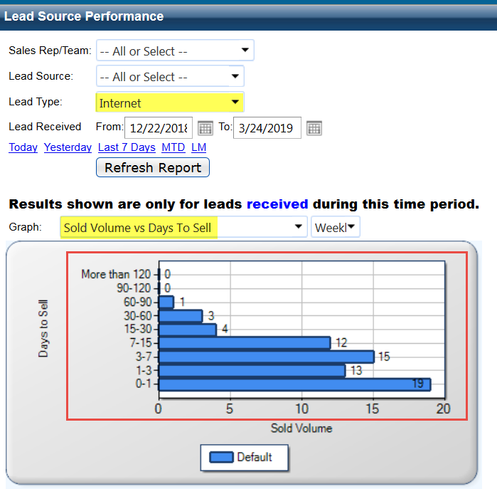
Identify Your Timeline

Slide 15
Tag…you’re it!
Notes:
It’s not just a game, it’s your business

Slide 16
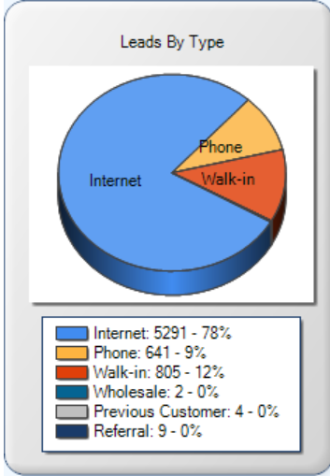
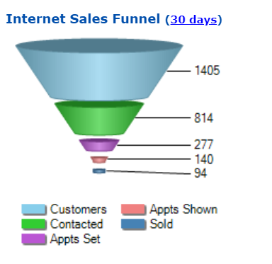
The "What" and The "Why "
78% of this business is internet
Closing internet leads Around 7%
So what happened to the 93% of our business
  “we are working them”
  “hammering the phone”

Slide 17
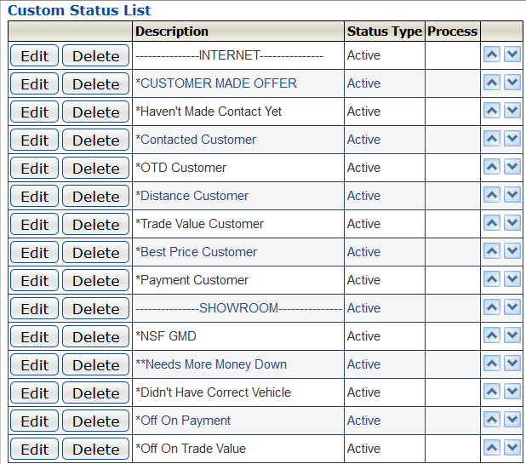
Statuses = Tagging
Most stores uses statuses to trigger process changes
Most store use statuses in automation within a process.
A different way of looking at reporting.
Reporting consists of all controlled data
  Leads, appts set, show and sold
You can use statuses to tag your leads and report on every opportunity for where we can identify failure (failure is the best thing when it is reporting on the business you “didn’t” sell)

Slide 18
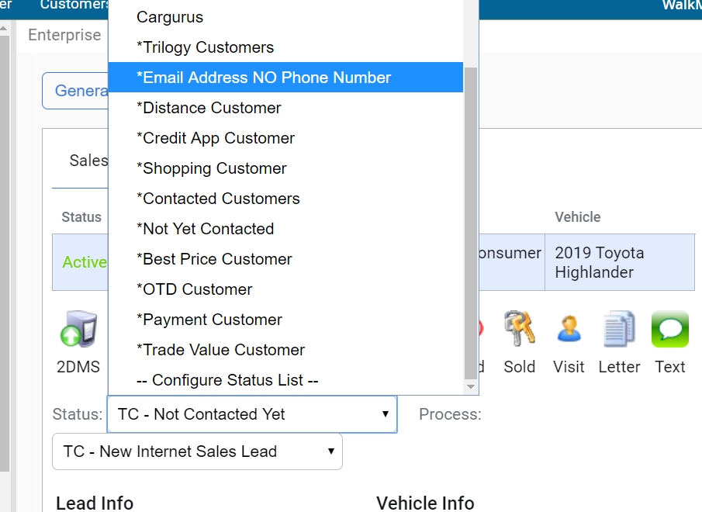
Tagging every phone and internet lead
Yes, manual,
It’s the only way to identify the “what and why” in our business..

Slide 19
Better utilization from sales staff with 1 on 1’s

Slide 20
All New Coaching Dashboard 1 on 1

Slide 21
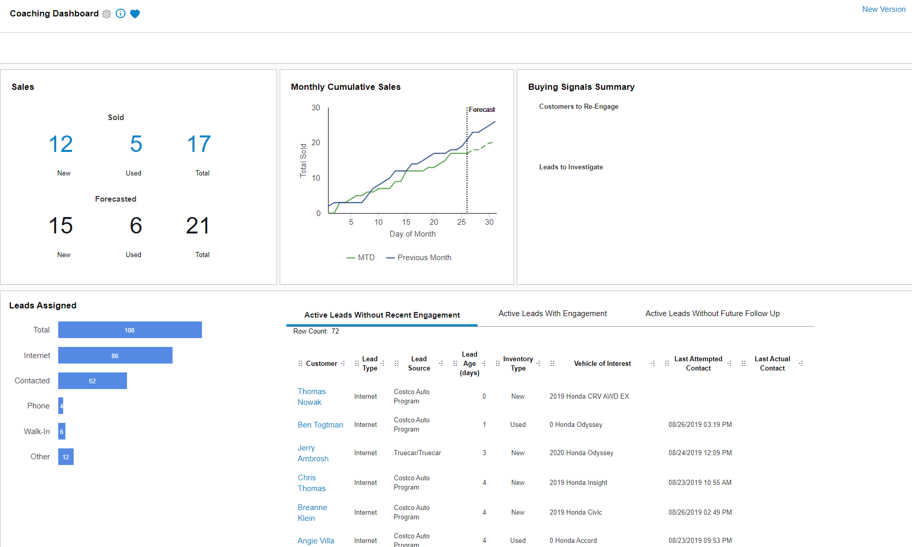

Slide 23
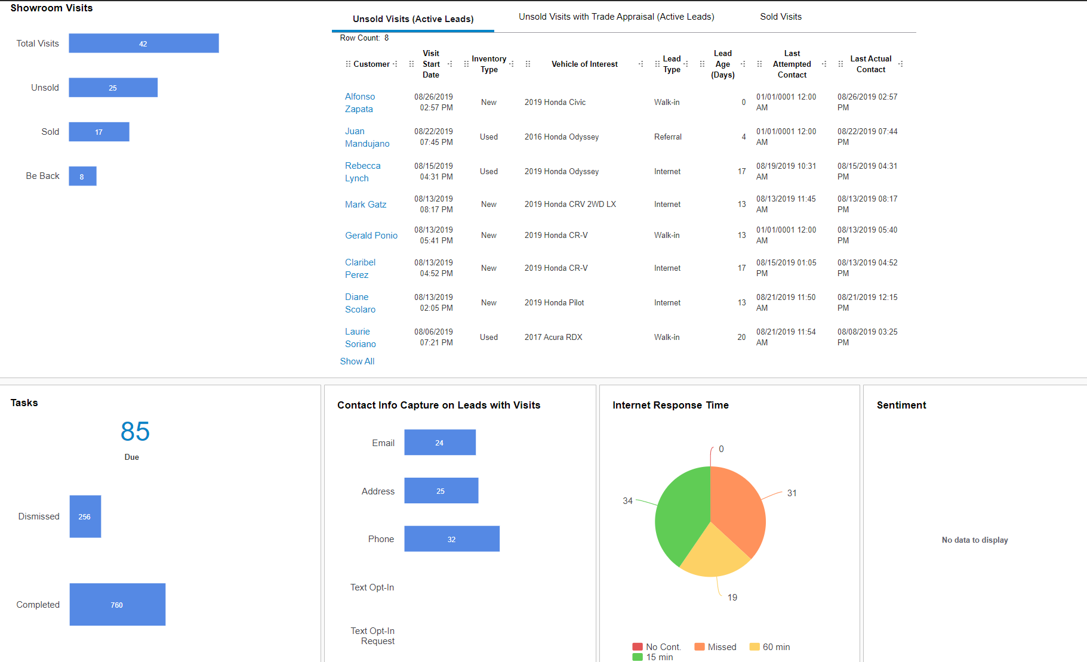

Slide 24
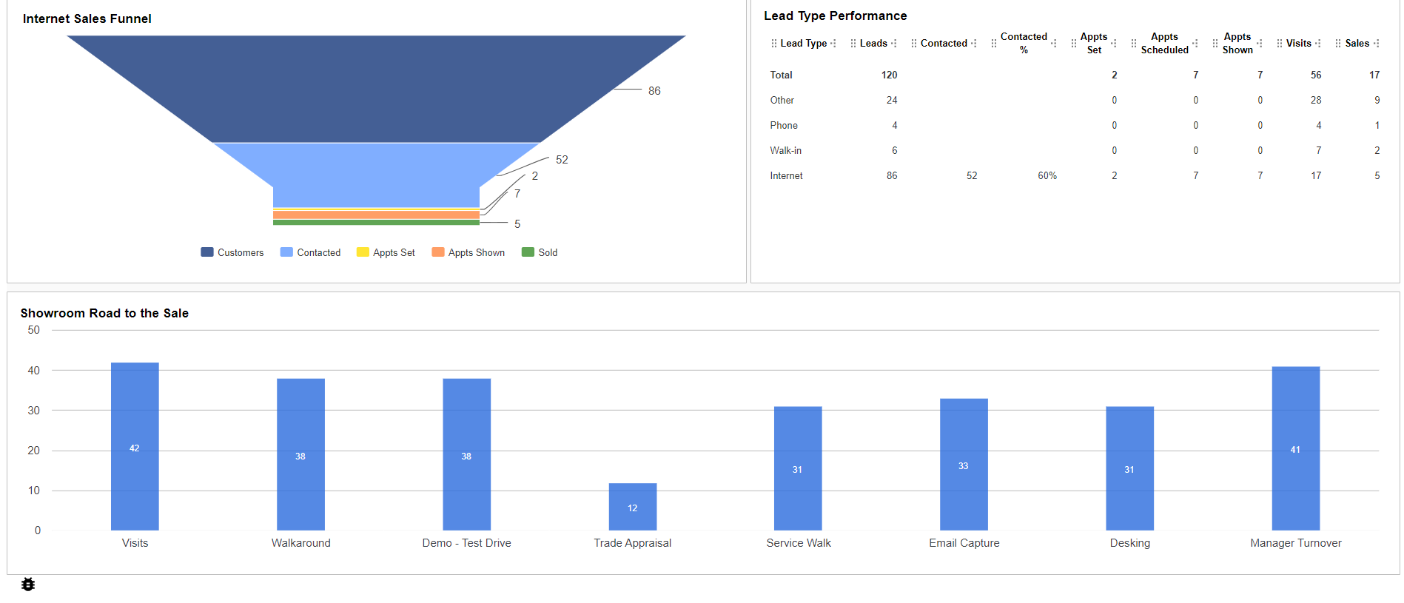

Slide 25
Red Flags and Understanding Settings
The BIG RED Button

Slide 26
What you want, What you have, Does it work?
Internal sales process
What you want to happen
CRM Processes
What the CRM is sending to the Users
Does it make sense? Is it the best process for your store?
Notes:
There are 2 different topics here:
1. Your internal sale process (mindset / focus on selling the right thing)
2. Your designed process of step by step things to do (CRM Processes)
Best Practice: “Communicate with the Right Message / Right Time”

Slide 27
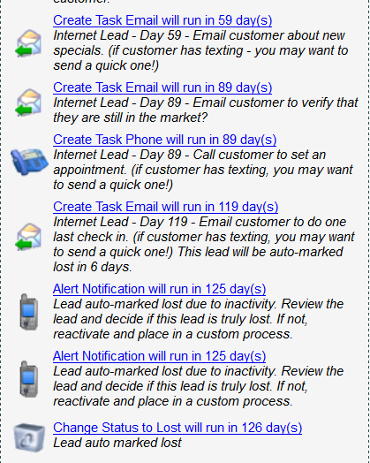
Settings> ILM/CRM Settings> Sales and Service Processes
Find your process first
  Basic system process timelines
    Internet Sales Lead
    Showroom Follow Up (Unsold)
    Phone Lead
  How many events are there in each of your processes. Do they make sense?
  Identifying the amount activity for your “Users” and “Teams”
  Compare that to the Lead Source Performance Report to identify a proper “Timeline”

Slide 28
Where can we identify where the work begins and the activity stops?
Work: Follow up until they say “NO/Stop”
Activity: Follow up for a time period that makes sense
  Then let the system follow up until they say “Uncle”
    This is the activity period where we have the best opportunity.

Slide 30
Let the CRM Work For You!

Slide 31
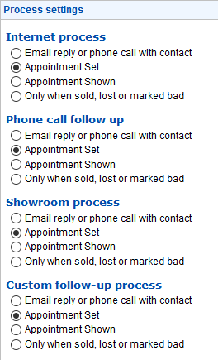
How CRM Processes Work
What stops a process or changes the follow-up?
1. A Process Termination Setting happens
Available on 4 standard processes
2. When a process reaches its end
3. Termination event is reached in a process
Change Status to Bad Event
Change Status to Lost Event
4. A major event happens
A showroom visit is started
Lead is marked Sold, Lost or Bad
A custom lead status is selected that has a process assigned

Slide 32
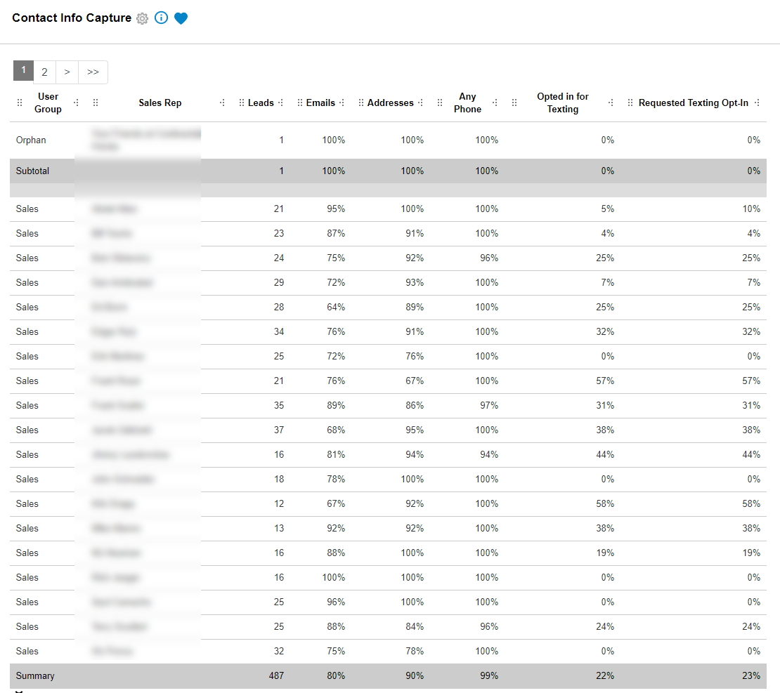
Do We Have the Data?

Slide 33
Who’s Responsible?

Slide 34
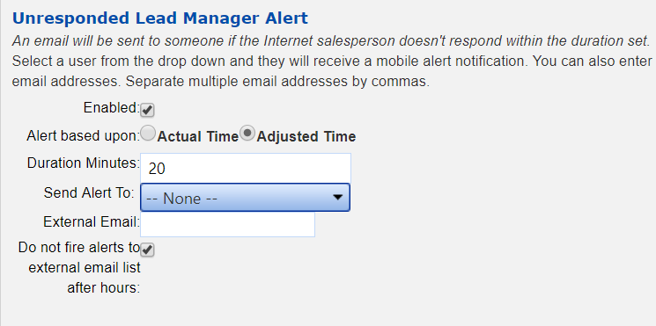
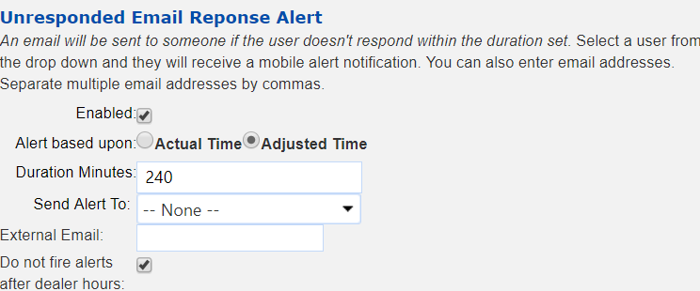
Do You Have a Handle on Your Opportunities?
Unresponsive leads
Time kills deals in time of the lead
If we spend so much time trying to get engagement
When they reply, why is it hard to watch how we reply

Slide 35
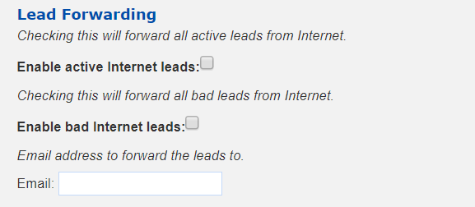
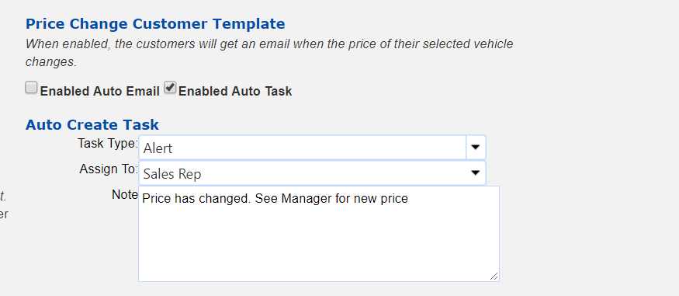
Small Settings That Can Cost You or Make You Money
Lead forwarding
Someone can put email in and all your leads forward.
Keep your leads safe
Price change alerts
Most stores create tasks.. Why not automate ?
Don’t we have enough to do?

Slide 36
Recap
How to identify opportunities in VinSolutions
  Communication of our business
  What's the buzz about LOST?
  “Tag It”
Better Utilization from your sales staff with 1 on 1’s
  Activity Breakdown
  Coaching Dashboard
  Transparency of Goals
How to identify red flags and understand settings in VinSolutions
  The Big Red Button “Shut Offs”
  Why don’t we answer and who is responsible
  Capture %, Dashboards and Lead Settings

Slide 37
Any Questions?
Kevin Schmitt
Sr. Performance Manager
VinSolutions CRM

Slide 38
Questions?

