Slide 2
Super Strength

Slide 3
Focus, Value and Customer Wins with Connect Desking

Slide 4
Kevin McCarthy VinSolutions Performance Manager

Slide 5
Agenda
Customer Experience vs. Customer Expectation
Desking Best Practices
Quick, consistent multi-payment proposals
Quick Print and Quick Pencil
Take-aways

Slide 6
Fun Fact 54,027,885
Notes:
Number of Retail scenarios created this year in Vin Desking

Slide 7
Point of Contact
They’re finally here!
Notes:
Contact%, Appointment setting, Confirmation, campaigning and follow up all lead to this moment.

Slide 8
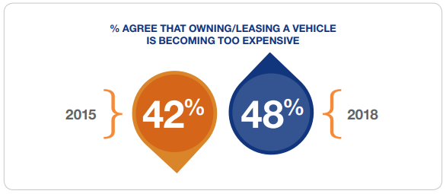
Experience vs Expectation
2019 Car Buying Journey Study Shows
CONSUMERS INCREASINGLY FEEL THAT OWNING A CAR IS TOO EXPENSIVE
Notes:
https://www.coxautoinc.com/learning-center/2019-car-buyer-journey-study/

Slide 9
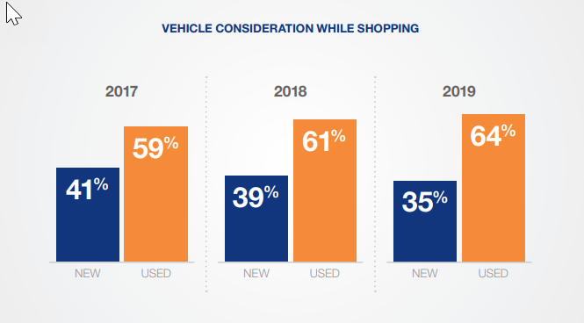
Experience vs Expectation
2019 Car Buying Journey Study Shows
Consider presenting a Pre-Owned vehicle as an alternate Selection
Notes:
https://www.coxautoinc.com/learning-center/2019-car-buyer-journey-study/

Slide 10
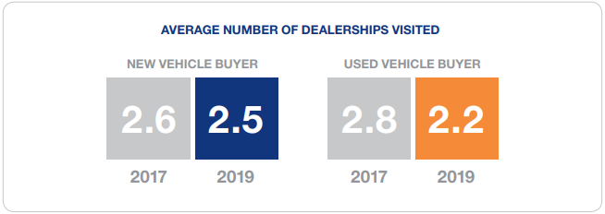
Experience vs Expectation
2019 Car Buying Journey Study Shows
CAR BUYERS ARE VISITING FEWER DEALERSHIPS
Notes:
https://www.coxautoinc.com/learning-center/2019-car-buyer-journey-study/

Slide 11
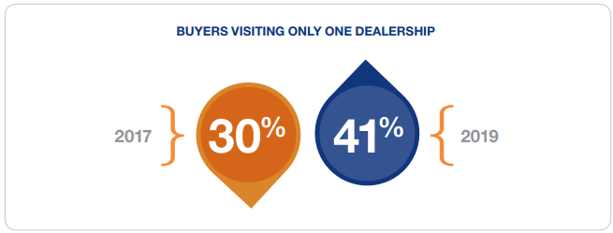
Experience vs Expectation
2019 Car Buying Journey Study Shows
CAR BUYERS ARE VISITING FEWER DEALERSHIPS
Notes:
https://www.coxautoinc.com/learning-center/2019-car-buyer-journey-study/

Slide 12
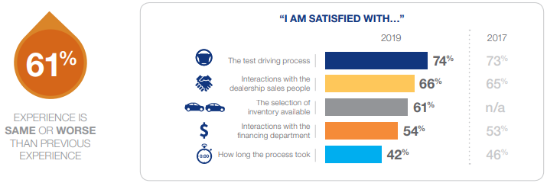
Experience vs Expectation
2019 Car Buying Journey Study Shows
Paperwork and negotiating are still the most frustrating parts of the car-buying process
Notes:
https://www.coxautoinc.com/learning-center/2019-car-buyer-journey-study/
Integration with DT, Rt. One and DMS

Slide 13
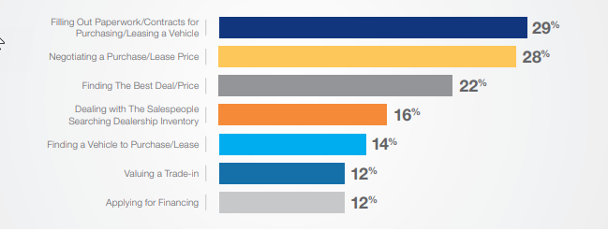
Experience vs Expectation
2019 Car Buying Journey Study Shows
TOP FRUSTRATIONS WITH PURCHASE PROCESS
Notes:
https://www.coxautoinc.com/learning-center/2019-car-buyer-journey-study/
Have integration w/DT, Rt. One and DMS all worked out.

Slide 14
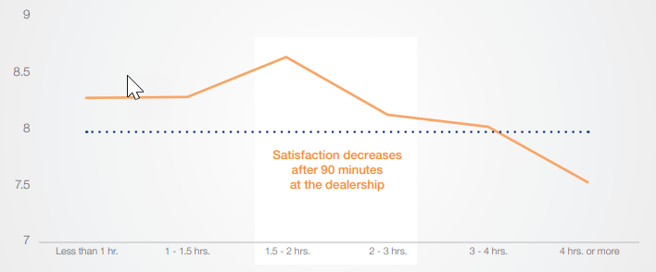
Experience vs Expectation
2019 Car Buying Journey Study Shows
OVERALL DEALERSHIP EXPERIENCE VS. TIME SPENT AT THE DEALERSHIP
Notes:
https://www.coxautoinc.com/learning-center/2019-car-buyer-journey-study/

Slide 15
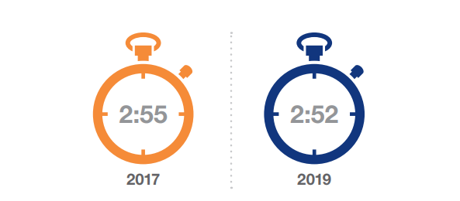
Experience vs Expectation
2019 Car Buying Journey Study Shows
TIME SPENT AT THE DEALERSHIP OF PURCHASE
Notes:
https://www.coxautoinc.com/learning-center/2019-car-buyer-journey-study/
Integration with DT, Rt. One and DMS.

Slide 16
Fun Fact 12,887,845
Notes:
Number of lease scenarios created this year in Vin Desking

Slide 17
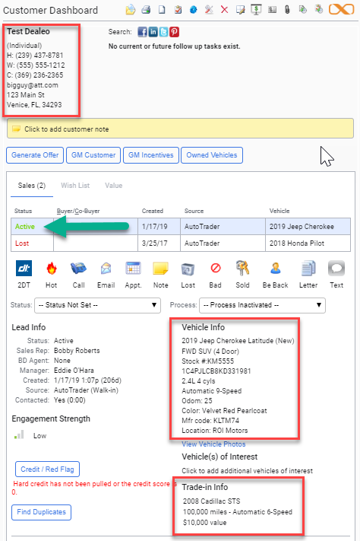
Best Practices
Data Capture –
No Short Cuts
Name
Phone #s
Email Address
Vehicle
Trade-in
Notes:
Are you OK with NO Follow Up?

Slide 18
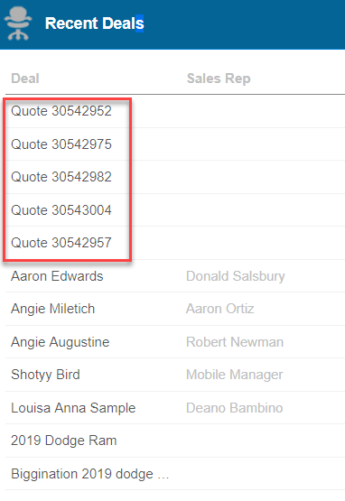
Best Practices
No Data Captured
Not tied to a customer
Not an Active Lead
Closing Rate Too High
Still Desking out of the DMS

Slide 19
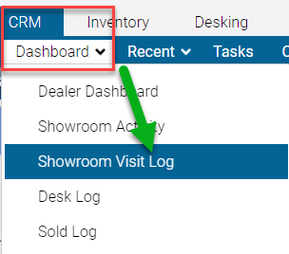
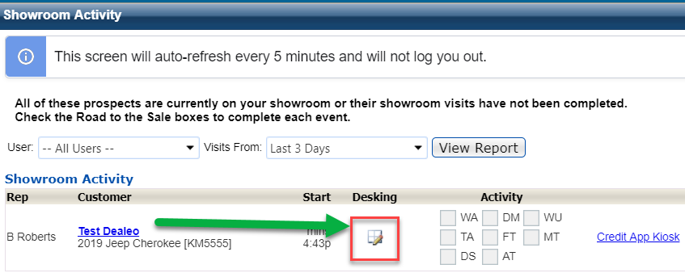
Best Practices
Desk from Showroom Activity Tab
Notes:
Would you be ok with NO Follow Up?

Slide 20
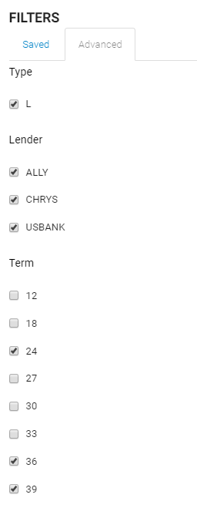
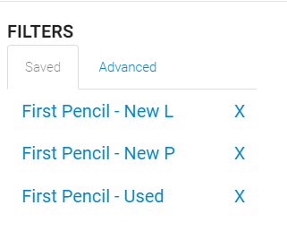
Best Practices
Create Templates in Rates and Residuals
Notes:
Speed up the process

Slide 21
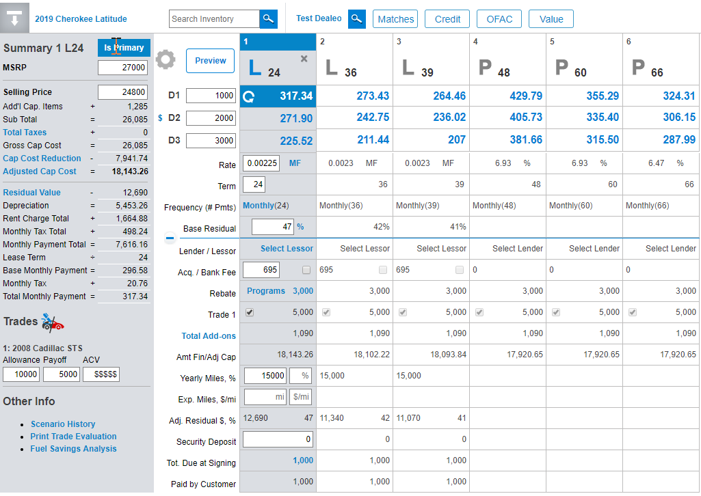
Best Practices
Give Options
3 Retail
3 Lease
3 Down Payments
18 Options Max

Slide 22
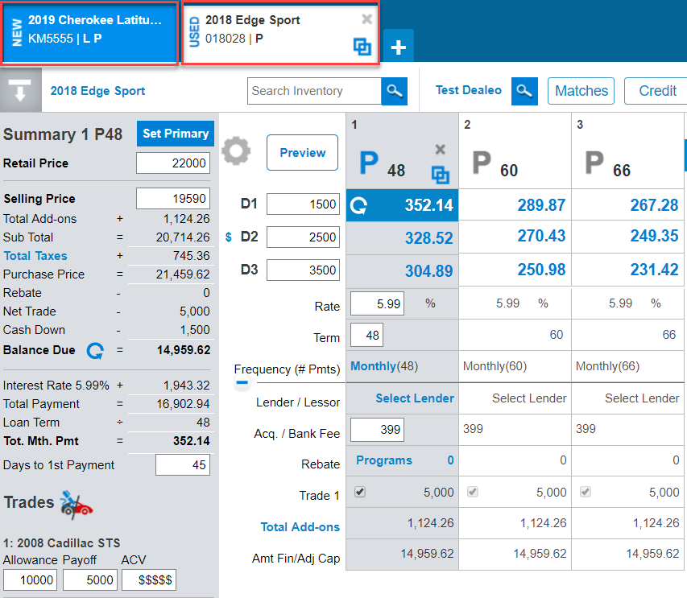
Best Practices
Give Options
New vs. Used

Slide 23
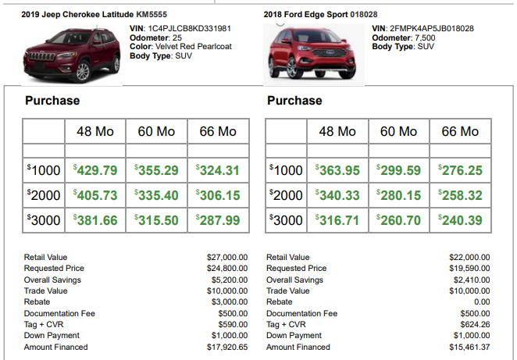
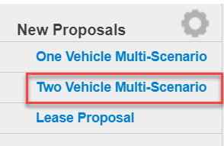
Give Options

Slide 24
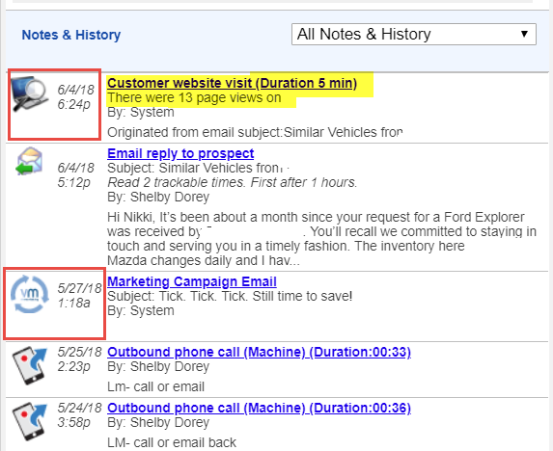
Best Practices
Know what they’ve seen
VinLens
Recent Campaigns

Slide 25
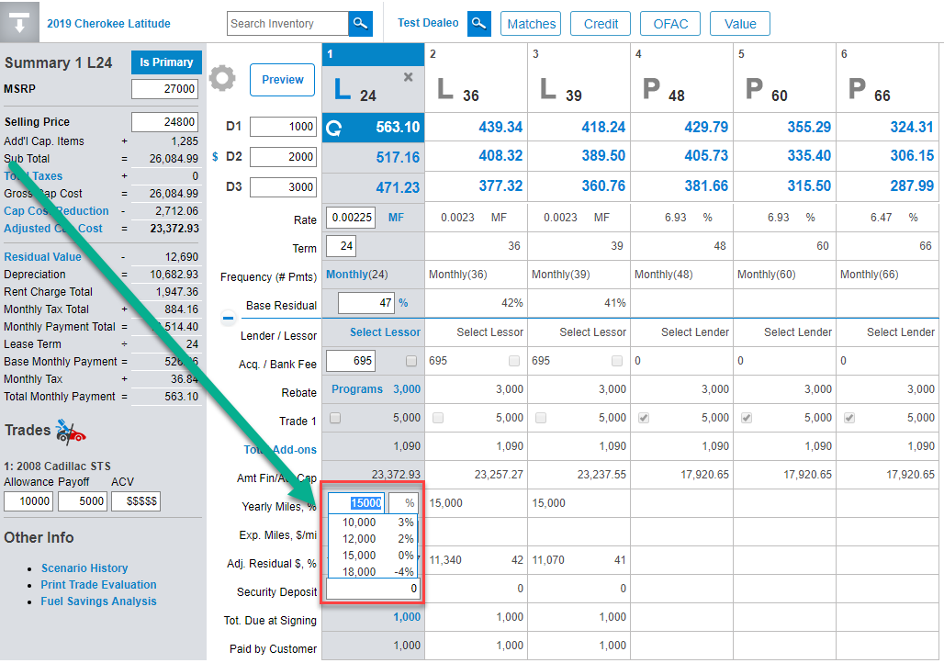
Best Practices
Give Options
Make Quick Mileage Adjustments

Slide 26
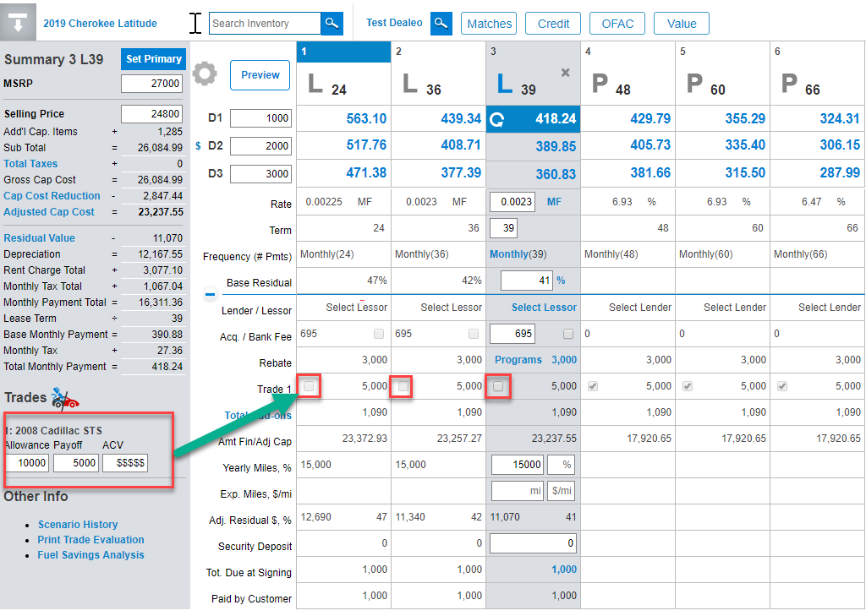
Best Practices
Give Options
Easily Include or Exclude the trade

Slide 27
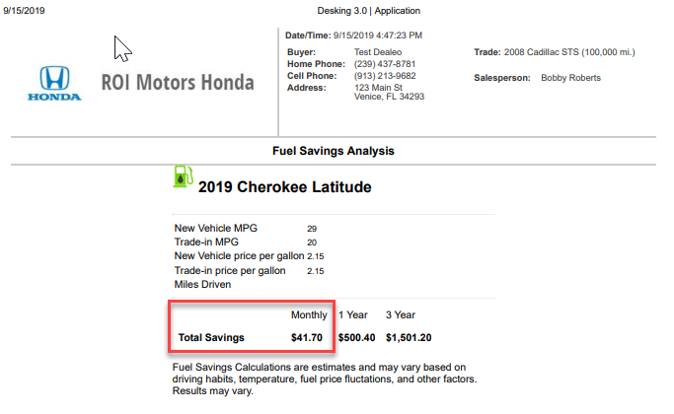
Best Practices
Gas Mileage Comparison

Slide 28
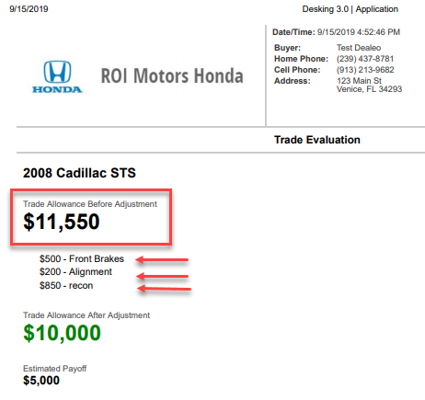
Best Practices
Trade Evaluation

Slide 29
Fun Fact 9,058,302
Notes:
Number of proposals printed this year in Vin Desking

Slide 30
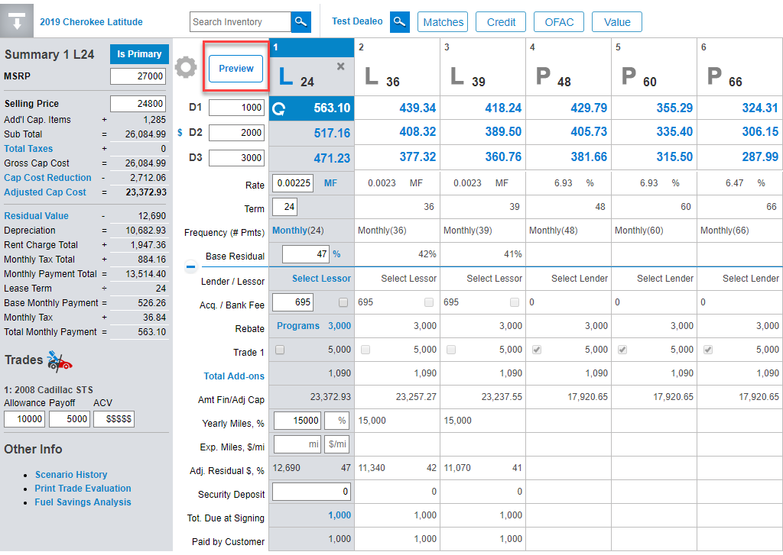
Quick Print
Preview and Email Options

Slide 31
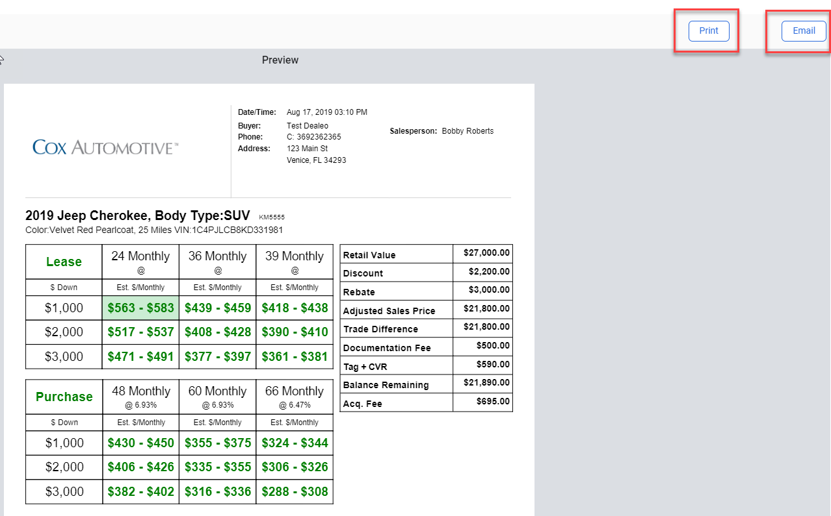
Quick Print
Preview and Email Options

Slide 32
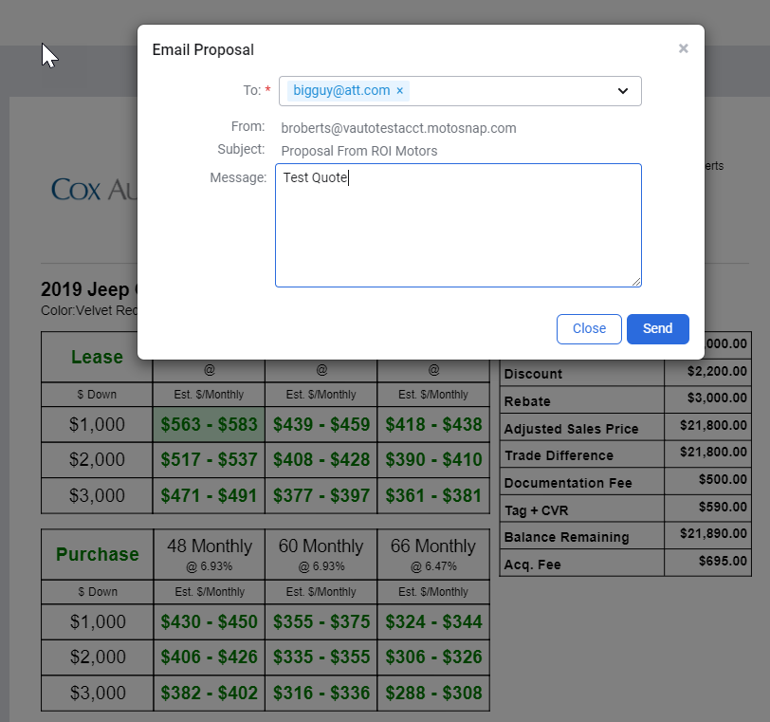
Quick Print
Preview and Email Options

Slide 33
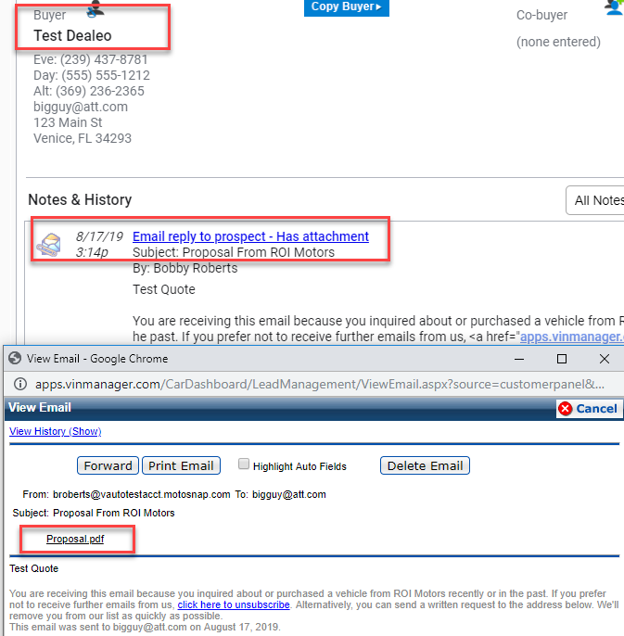
Quick Print
Email Proposal is in the Customer Notes and History
Notes:
The salesperson has a copy easily accessible. No disconnect between the customer and SP.

Slide 34
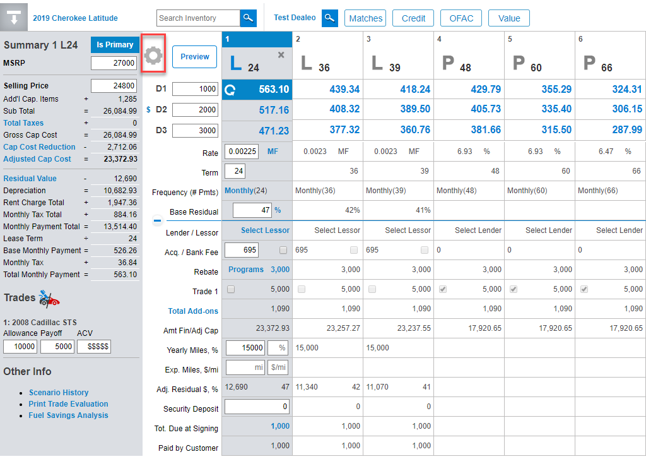
Quick Print
Setup
From Any Desked Deal

Slide 35
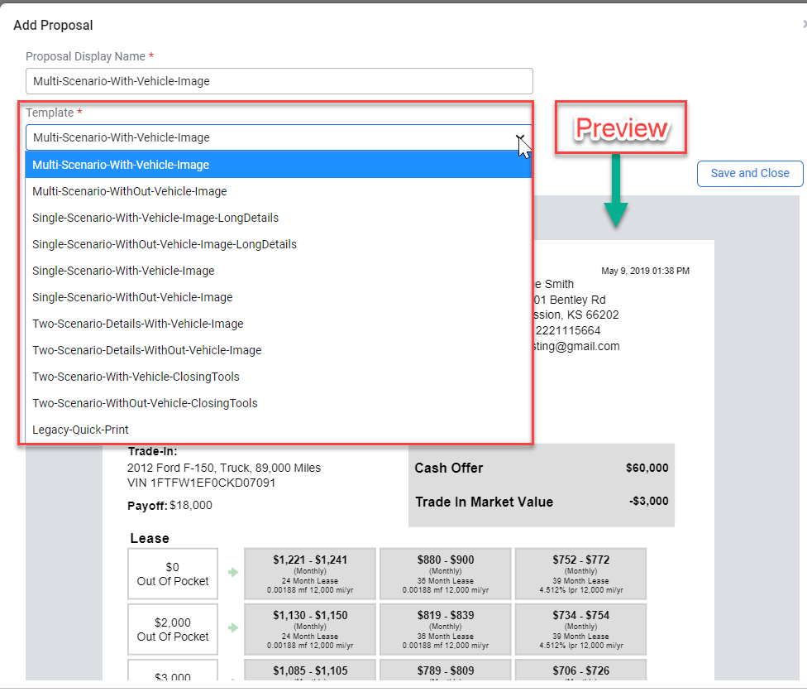
Quick Print
Setup
Add Proposals
12 Pre set scenarios to chose from

Slide 36
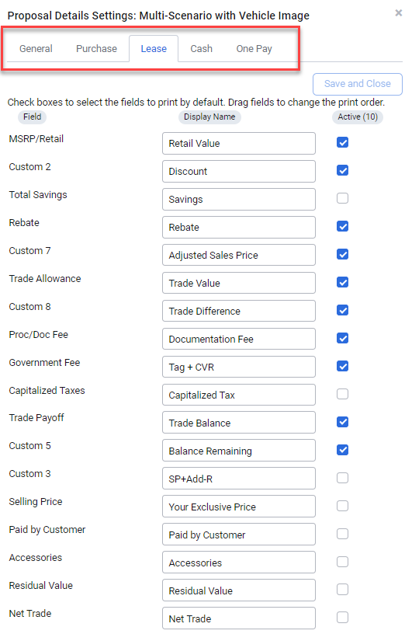
Quick Print
Setup
Edit and Save Default Settings
Purchase
Lease
Cash
One Pay

Slide 37
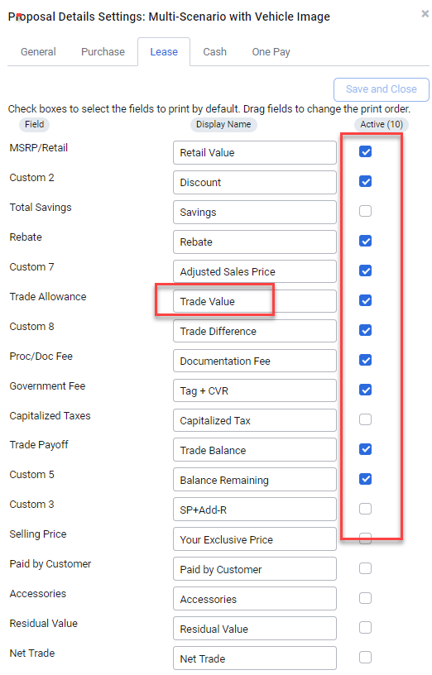
Quick Print
Setup
Setup What you want to show
Label the Terms used
In the order you want to show them

Slide 38
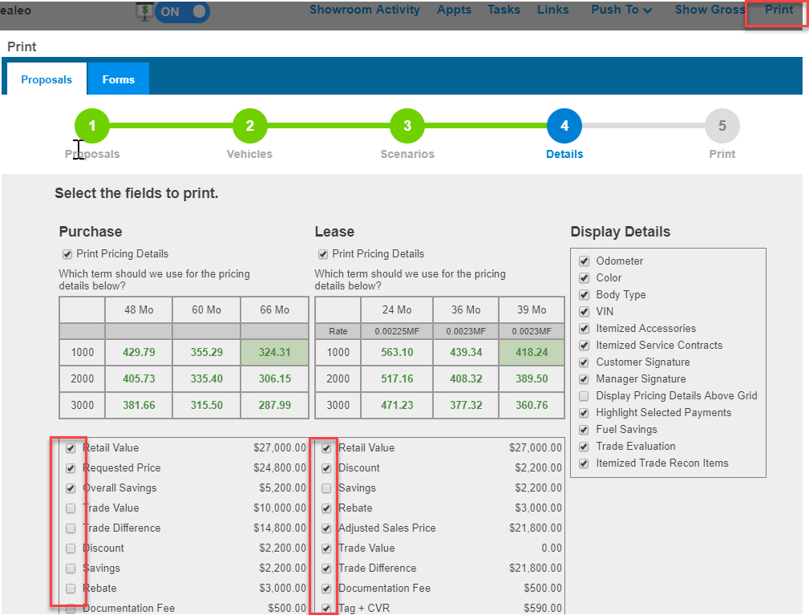
Standard Print
The Option to Print from the Standard Print is still Available

Slide 39
Quick Pencil
Notes:
¹Cox Automotive Car Buyer Journey, 2018
Source: Cox Automotive Future of Digital Retail Study, 2017

Slide 40
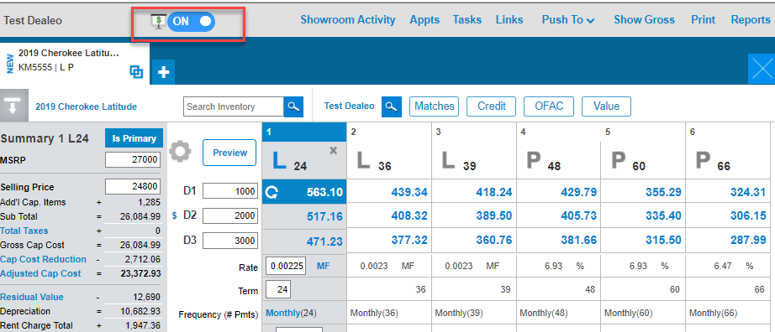
Quick Pencil
Reduce the amount of time a Salesperson is away from the customer
Notes:
When do we start to lose control?

Slide 41
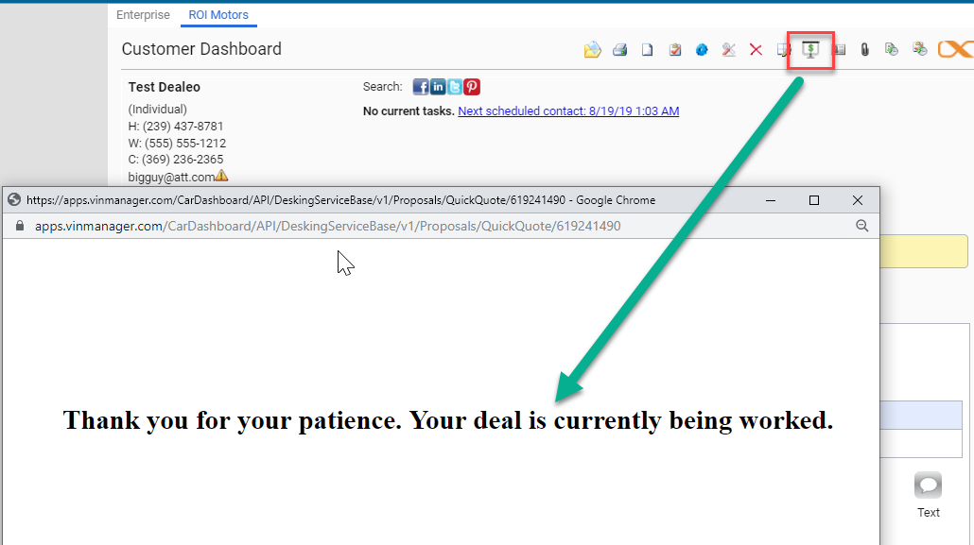
Quick Pencil
Re-Work
the Deal and show when you’re ready

Slide 42
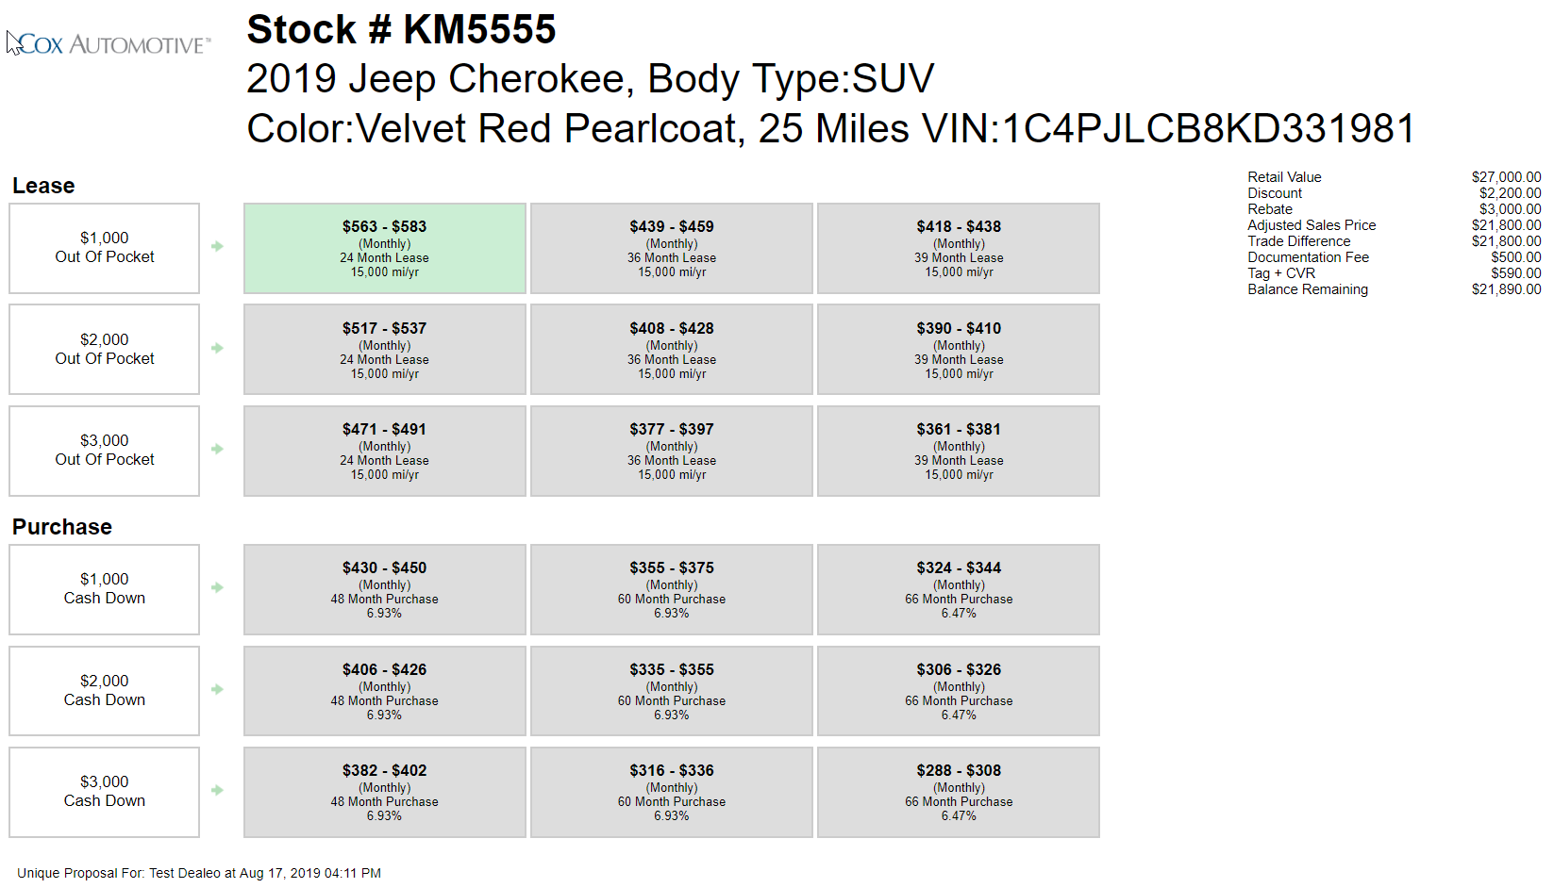
Quick Pencil
Professional
Proposal from the Customer Dashboard
Notes:
Who’s from F&I? Why do we do a menu presentation?

Slide 43
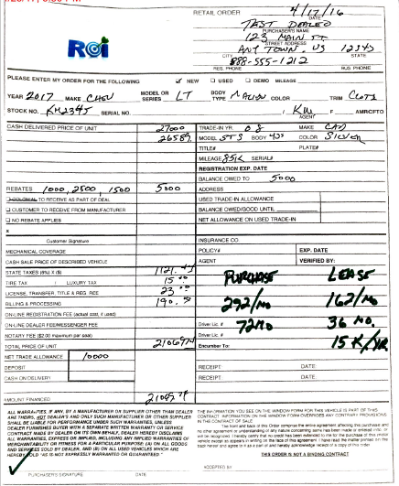
Quick Pencil
Too Slow and Hard to Understand
Less Believable

Slide 44
Quick Print/Pencil
Dealer Benefits
Quick Process
Consistent Presentation
Less Back and Forth
Sell a Car rather than The Car
Increased Lease Penetration
Notes:
Why do we train on a consistent walkaround? Should be the same consistency with the desking proposal.

Slide 45
Quick Print/Pencil
Customer Benefits
More Options
Fulfills the Desire to Shop
Quick/Professional Presentation
Better Customer Experience

Slide 46
Fun Fact 6,388,282
Notes:
Proposals with a trade-in this year in Vin Desking

Slide 47
Key Take-aways
Be Prepared (VinLens, Campaigns, Etc.)
Time Expectation
Help them through the process
Give them Options, Menu Presentation
Have Scenarios setup
Use Quick Print/Pencil Consistently
Train your Staff (Practice, Drill and Rehearse)

Slide 48
Questions?

Slide 49
Thanks for Attending! Kevin.mccarthy@coxautoinc.com

