Slide 1
WiFi
Network: Vinworx
Password: vinworx2019
Notes:
In this session, you will learn how to SHAPESHIFT your BDC

Slide 2
Notes:
Welcome to VinWorx 2019 – our theme this year is Unleash Your CRM Superpowers

Slide 3
Shapeshift
your BDC
Notes:
In this session, you will learn how to SHAPESHIFT your BDC

Slide 4
Megan Barto
Performance Manager
Notes:
My name is Megan Barto & I am a Performance Manager with VinSolutions.
After being in a dealership for over a decade I decided my passion was helping dealers sell more cars using their CRM. I started working with internet leads back when my GM came to me & said, “You have a computer and you type pretty fast – do you want to handle internet leads?” Shortly after – I ran a bdc for a dealer group in South Central Pennsylvania.

Slide 5
Agenda
X Ray Your Current BDC
Are you set up for Success or Failure?
How is Your Customer Experience?
Texting Strategies For Today’s Customer
Takeaways
Questions
Notes:
In order to Shapeshift your BDC we have to look at few things.
X-Ray your current BDC
Determine if you are set up for success or failure.
How is your current customer experience?
Texting strategies for today’s customer.
Takeaways
Questions

Slide 6
X-Ray Your Current BDC
Notes:
In order to improve – you to figure out where you currently are. What are the important a successful BDC? Let me show you some of the most important ones….

Slide 7
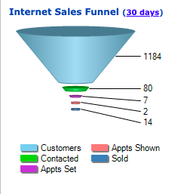
What’s your current situation?
Notes:
How many of you log into VinSolutions everyday?
We put this on your dashboard because it’s REALLY REALLY IMPORTANT.
Who can tell me what we mean by “contacted” here?
Main dashboard – 1184 total
80 contacted
7 Appts Set
2 Appointments Shown
14 Sold
Before we break this down – who can tell me what “contacted”
Contact Rate is 6%
Is this the sign of a good BDC?
Have any of you ever seen this starting number not match another report in the CRM?
Manually added are in here. Aside from Manager+ someone who has “Internet Salesperson” user role checked can manually add an internet lead.

Slide 8
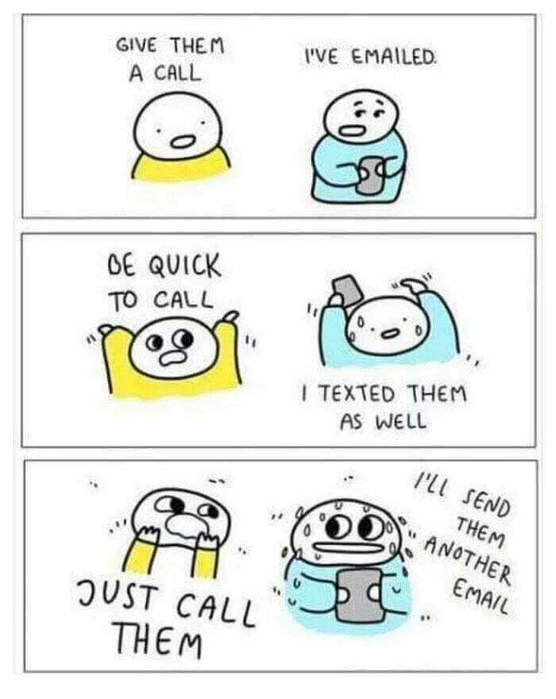
But what works best for your customers?
Notes:
So how many of you have salespeople who hate calling customers? They’d rather text or e-mail?
Look at your low contact ratios – how many people are actually picking up that phone that weighs 2,000 lbs?

Slide 9
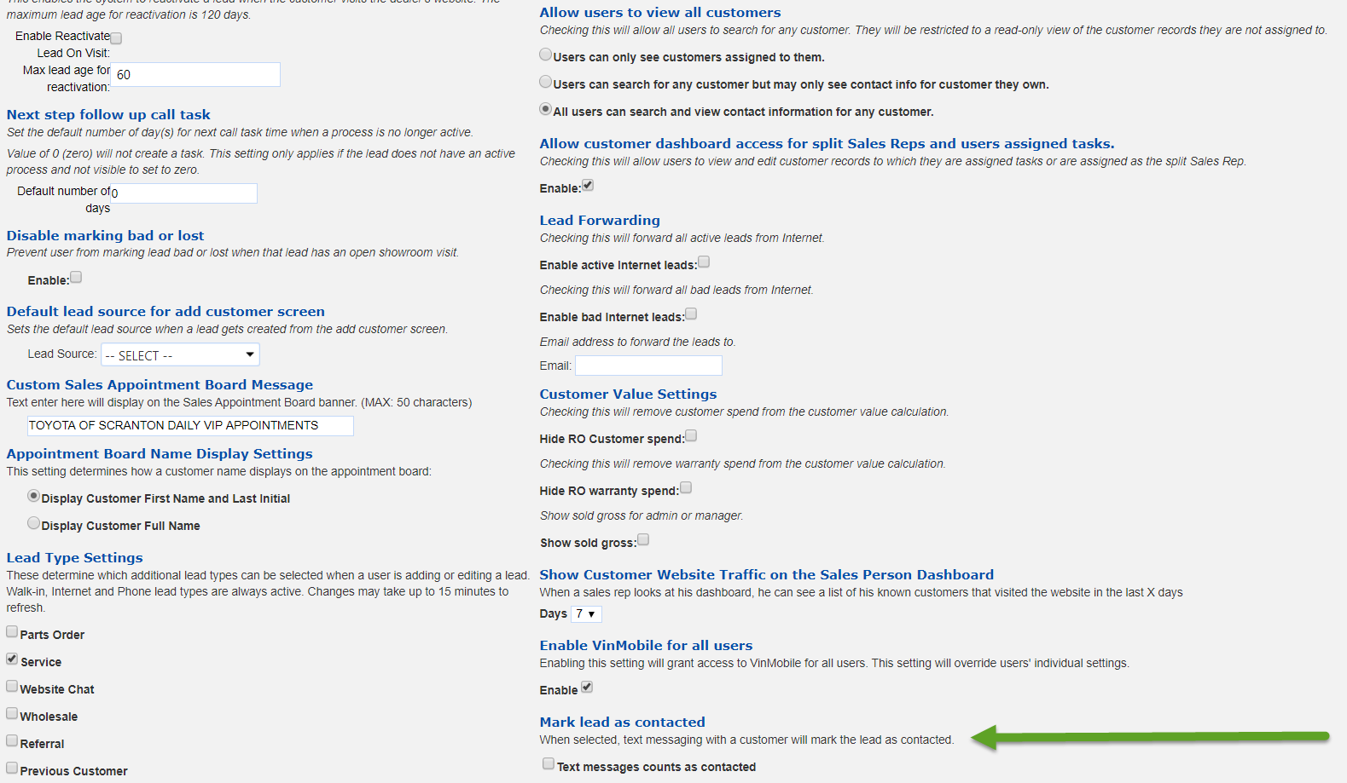
Notes:
How many of you use texting in the system?
Great news! We added a settings that on a per-dealership- basis, texting will mark the customer as contacted.
The click path to get to this is Settings – ILM/CRM Settings – Lead Settings, navigate to the bottom of the page, right hand list as indicated in the screen shot.

Slide 10
Audi
BMW
General Motors
Hyundai
Jaguar Land Rover
Kia
Mitsubishi
Subaru
Toyota
Volkswagen
Volvo
Current OEM’s Which Accept Text Message as an approved form of “First Contact Attempt”
Notes:
If your BDC handles leads from one of these OEM’s, write down that your OEM now accepts an outbound text message as a form of “Stopping The Clock”
Toyota, BMW, JLR, Subaru, Audi, VW, Mitsubishi, Volvo, Hyundai, Kia, GM

Slide 11
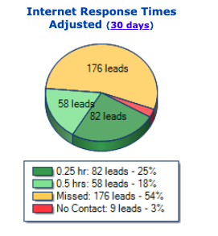
Close your eyes for a minute….
Notes:
Imagine you’re back in your showroom. Everyone is standing looking around staring at that glass window.
There’s a customer standing on the showroom floor. How long would you allow them to stand there for?
What’s the longest you expect it to take your team to wait to greet a fresh up?
This – is right beside the funnel from above. Because it’s that important.
This dealership uses 15 minutes as their dark green goal and 30 minutes as their light green goal.
These are customers who took the time to fill out a form on a website that you pushed them to asking for more information on a vehicle. If this customer had instead skipped the form and just driven to your dealership, would you let them stand there for 5 minutes let alone 15?
This store still has 9 people wandering around the lot that no one has spoken with.

Slide 12
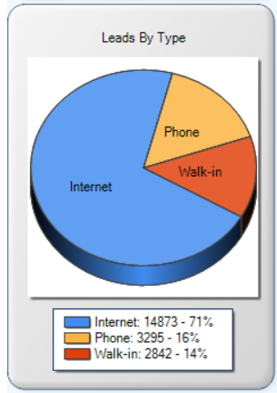

Notes:
How much do you spend on marketing? Directing where? OEM? 3rd Parties?
How many people spent money on a purple gorilla on their roof?
Just how much of your traffic comes from the internet?
Now that we’ve determined we pounce on walk-in customers but not as much internet leads, just how much of our traffic comes from the internet?
Across every dealership I work with, these numbers are about the same mix.
Go back to your stores and take a look at yours.
What if you let 71% of your traffic sit for an hour+ waiting for someone to reach out to them?
Only 14% of your traffic is walk-in, only 16% call in. If the phone isn’t ringing and people aren’t walking in you notice that. Who notices internet leads?
That’s why it’s important for the customers to have a good experience

Slide 13
Are you set up for success or failure? How do you know?
Notes:
I want to take you through some red flags, some reports to look at, some things to consider

Slide 14
Is your team working together?
Sales Managers
BDC
Notes:
Are your sales managers aware of the BDC role?
Do you know what to do with a BDC Appointment?
Customer experience suffers
Mark showroom visit – allow system to let BDC know customer is here. Do you pay them on shows? It’s not fair to those people dialing for dollars to not pay them on a show.
Customer experience – showroom floor, sorry you missed your appointment
Confirmation process?
Missed appointment?
What does this relationship look like?
Appointment Champion?

Slide 15
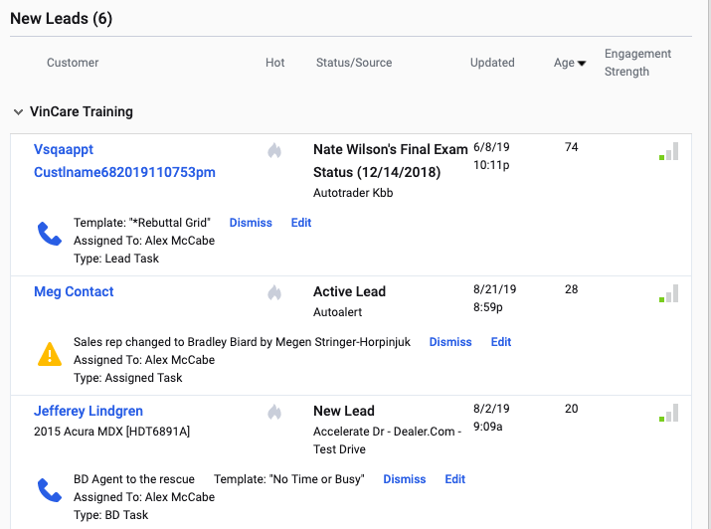

Set Up For Failure
Notes:
Here’s a store that’s set up for failure –
Missing all the goals 3126 new leads MTD -
This is why they look this way.
You’re getting too many leads for the amount of people you have.
Can’t get to them in time – stressed.
Customers aren’t getting acknowledged.
Terrible customer experience.
Beating people up to get response times down.
Can’t stay on top of it.
Over due tasks
Unanswered leads
Terrible response times.
E-Mails with no response
Use these reports to determine if you’re set up or not

Slide 16
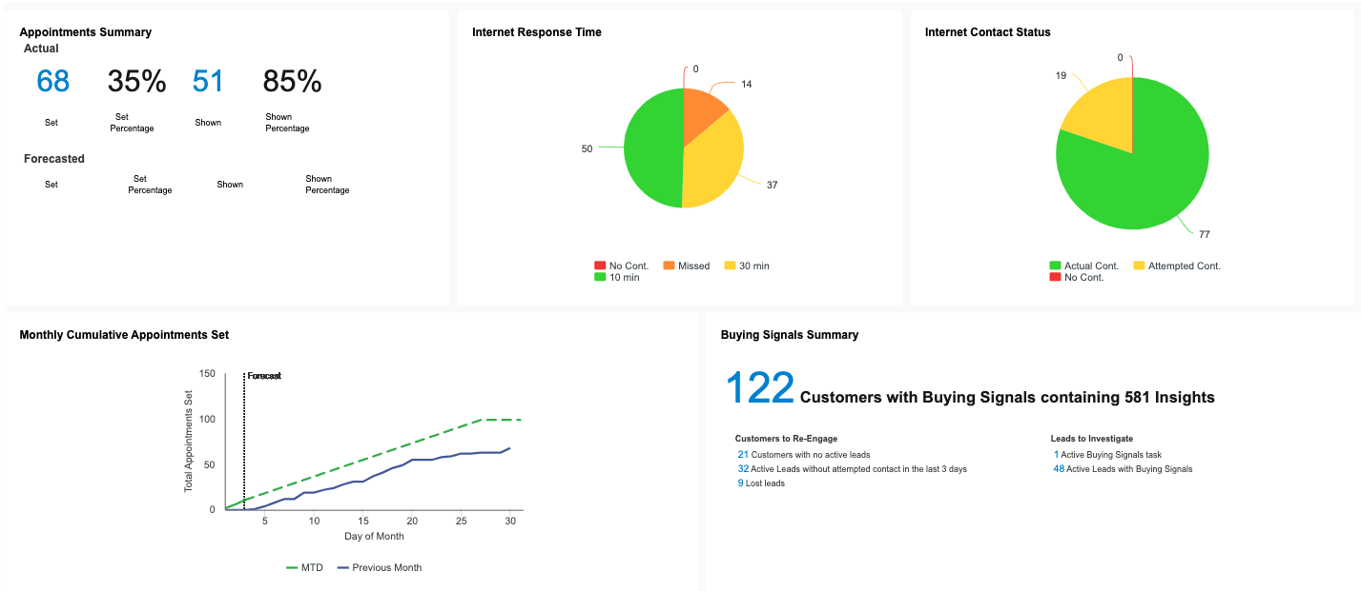
Coaching Dashboard - BDC
Notes:
What if you had one place to go to see opportunities/metrics for your BDC Agents. We took input from several top performing BDC’s & asked “what do you want to see on a Coaching Dashboard?”
This is what we came up with.
But right now, the Salesperson Coaching Dashboard is currently live. Salespeople will have access to see their own. It’s a great tool for those 1-on-1’s.
Customer names blurred out, but they are clickable.
All communication is clickable. Monitor your team’s messages.
Active leads with engagement and no set appointment
Released later this year – subject to change

Slide 17
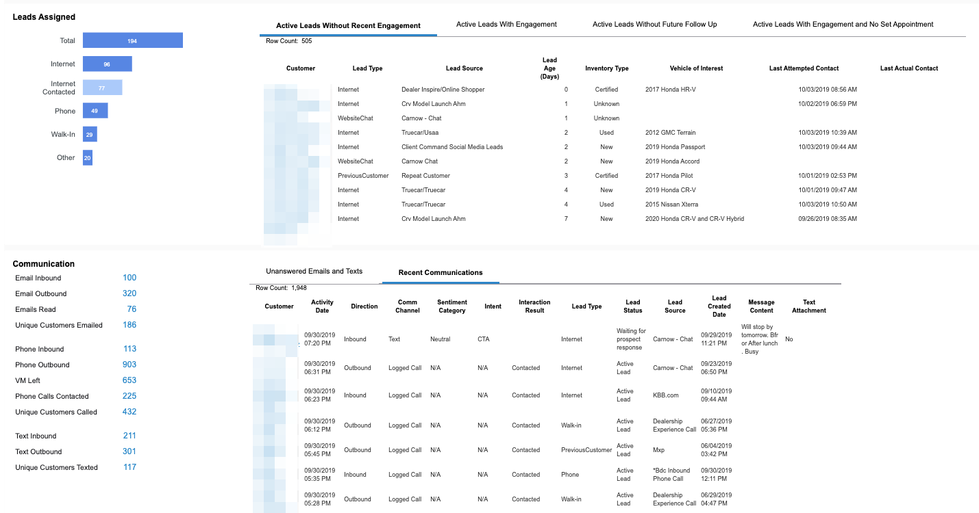

Slide 18
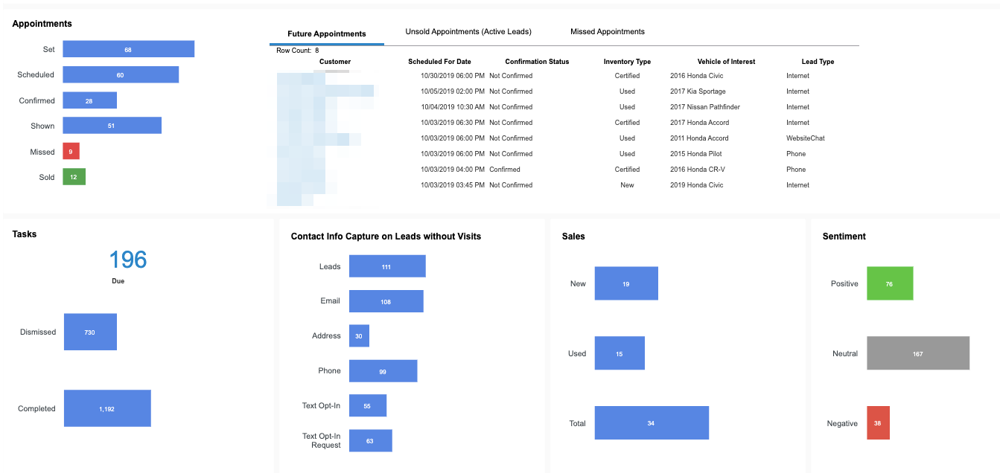

Slide 19
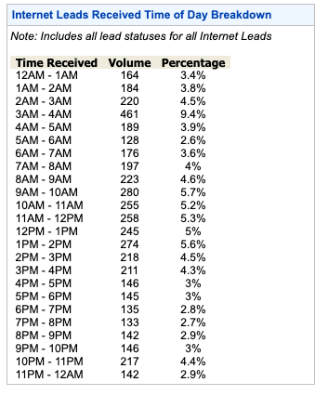
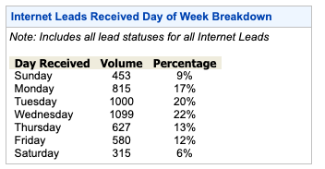
Lead Source Performance
Notes:
Set up your schedule according to when you get leads.
Look at Saturday – only 6%. I thought Saturday’s were all about all hands on deck and free pizza. Kinda seems like a waste in this store, right?
Make sure to look at this monthly to make sure the trends don’t change.

Slide 20
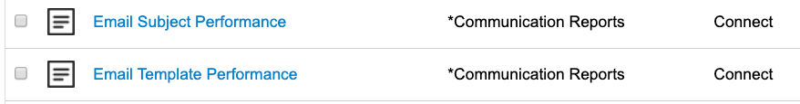
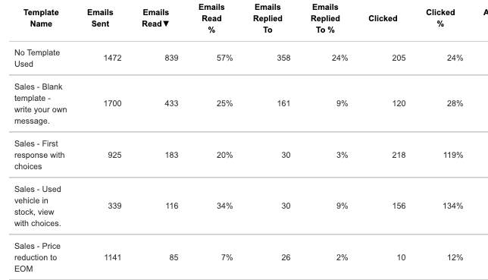
Monitor your Templates
Notes:
Why aren’t I contacting customers?
Are your subject lines engaging?
E-mail templates – do we have a process?
E-mail subject/templates performance
Why did only 80 people respond back out of 1100+ that raised their hand and said they might want to buy a car.
If you change a subject in a template, don’t just change the subject. Make an entirely new template and title it something like “First Response – 10.2.2019” that way, you can run this report and do a little A/B testing with your e-mail subject lines.

Slide 21
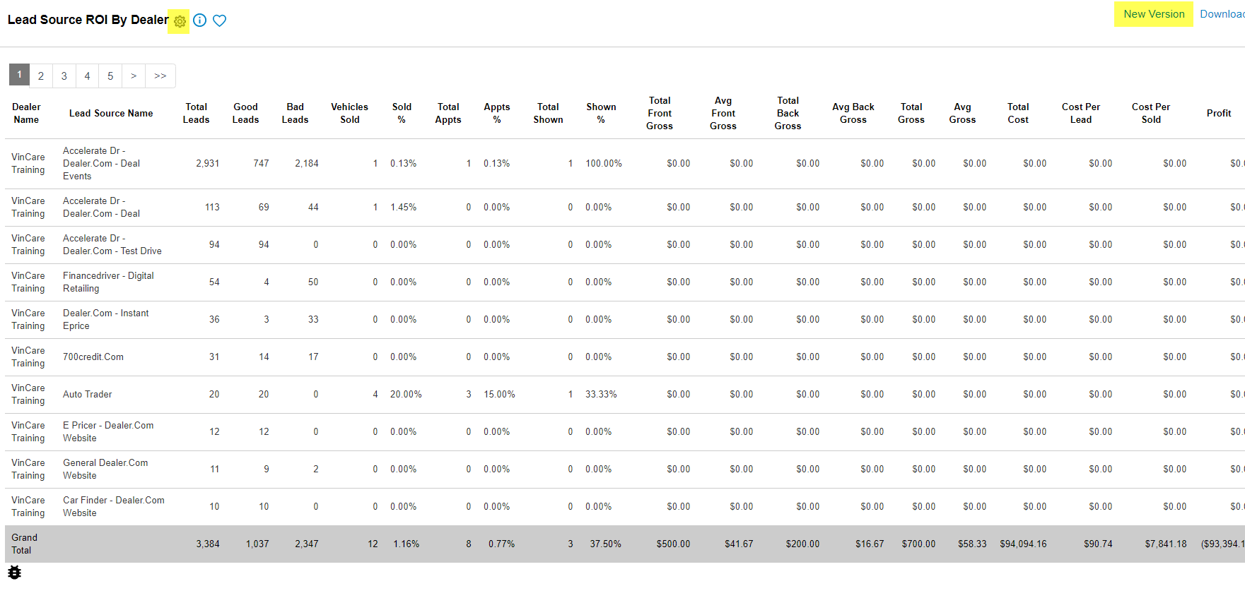
ROI
Notes:
ROI – how are your lead sources providing – customize report & then click “New Version” save it as your own – don’t have to reselect filters.
Instead of having 17 different truecar sources, group your lead sources. Single source – group anyway, otherwise wind up in ungrouped
How often do you look at your leads & decide if you need to fire them or not? We think monthly – at least every other month. Dive into why they’re not working. What’s the radius?

Slide 22
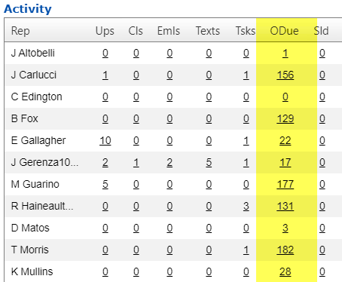

Non Negotiables
Notes:
Everyone knows what this picture is – ASK AN AUDIENCE MEMBER do you 100% belong in test-drives?
I’m a 20 car a month guy, I want to come to work at your store. But that test-drive thing, I don’t do that.
Non-negotiables
Customers not tasks.
Your processes have to be a non-negotiable. Once that’s true – the overdue tasks need to be non-negoitables as well. Once it’s a non-negotiable, it’s really easy to manage your CRM. If you have overdue tasks, that’s someone who isn’t working for you.

Slide 23
What is your current customer experience?
Notes:
Right people
Right lead sources
Do you check your on-line reviews?
Focus on customer experience
When’s the last time you secret shopped your store?
“THANK YOU FOR YOUR INQUIRY – A ROBOT COULD WRITE THE SAME TEMPLATE?

Slide 24
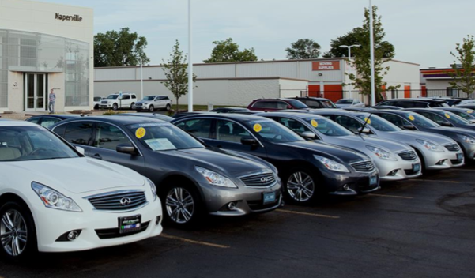
First Impression
Notes:
Who in here has been a Used Car Manager?
This is your front line -
Imagine the white car is parked far back & dirty with a cracked windshield.
Next car has a flat tire
Can you see the one with the windshield wiper up? In my store, the wiper up meant it needed gas.
What would you do if this was your front line?
How long until you call a lot party?
Why is it so important for that front line to be in tip-top shape?
What’s your first impression on the internet – where 71% of your customers are shopping
That’s your first impression.
Non-negotiable.

Slide 25

Thank you for your inquiry…..
When can you come in?
Notes:
Everyone says “thank you for your inquiry”
McDonalds experience – throw money
Chick Fil A – different experience
What if we gave our customers an experience they aren’t expecting?
Why do you spend time making sure your lot looks good? Why do we put balloons out? Why do we have a manager going out making sure the cars are lined up? First impression.
Are you satisfied with your first impression to your customer?
Do you have a road to the sale for your internet customers? ASK PEOPLE
How is that managed? Make sure all you said is true.
Do you have a mission statement?
Do your employees believe in it?
Do your customers know it? Including internet customers?
Ask yourself – how do you keep from being a Robot?

Slide 26
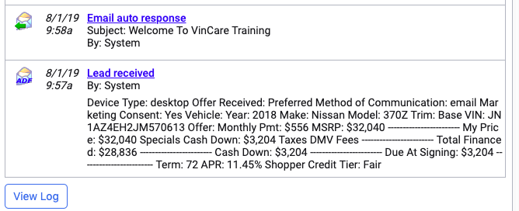
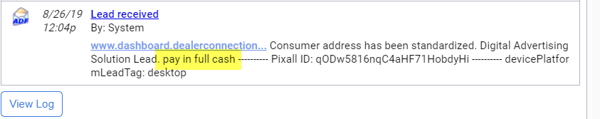
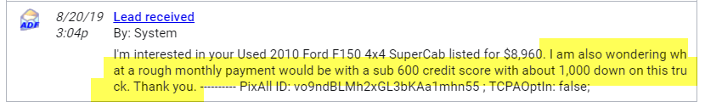
What’s In A Lead?
Notes:
Comments on the lead
Do you show your customers you care?
Shapeshift from a normal dealership robot with a canned response to someone who cares.
Acknowledge their comment.
Address that you read the question
I’m not telling you to give them payments/interest rate/otd numbers. I’m saying to read their question & acknowledge it. No one cares how much you know, until they know how much you care.

Slide 27
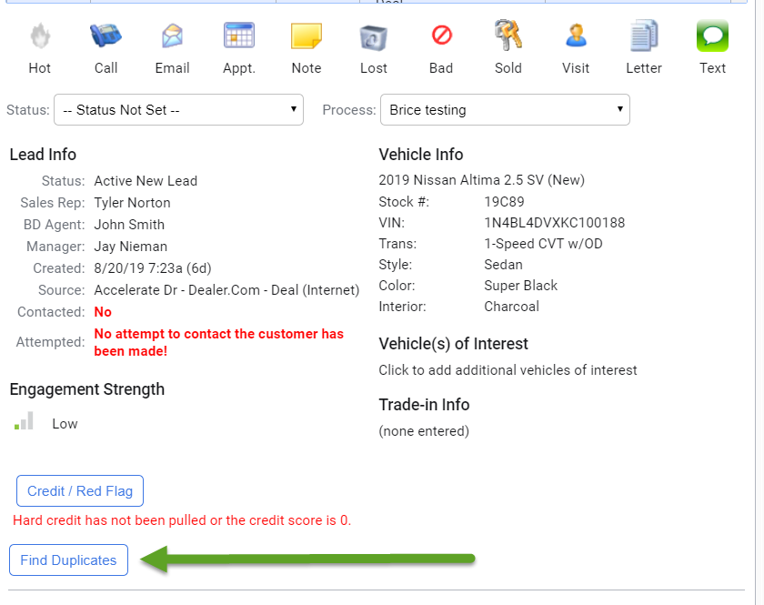
Duplication
Notes:
Another place to verify & be on top of things is. Hit find duplicates – customer experience (find duplicates button)
What if husband came into the dealership & test-drove a vehicle, but wife submitted the inquiry? We send wife a price $1500 below what we quoted husband when he was in the store.
Bad customer experience
Enterprise level – ”Find Duplicates” also works on an enterprise level. Wouldn’t it be useful if you could see if someone had a lead in your sister store?

Slide 28
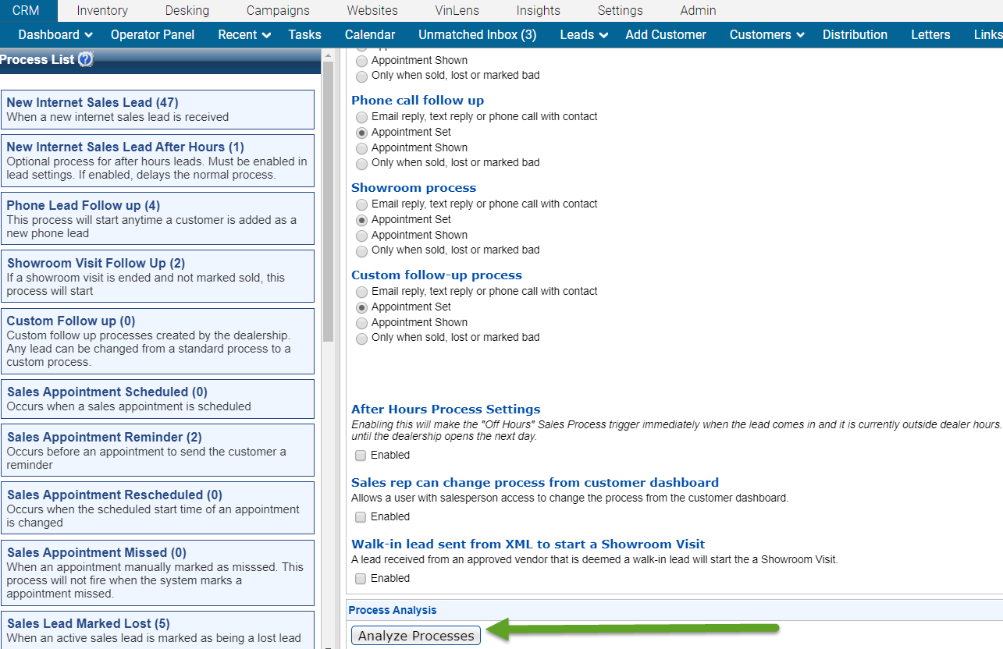
Notes:
This Analyze Process button – who’s clicked it?
This will tell you where the holes in your processes are. Missing templates, missing users, broken events.
Let’s say you had a particular Manager who would call every single customer 24 hours after a showroom visit. You had a task in your processes assigned specifically to him by name (not by user role). It worked really well – but then he left. And his username was deleted out of the system.
What happens to that call?
It doesn’t fire – to anyone.

Slide 29
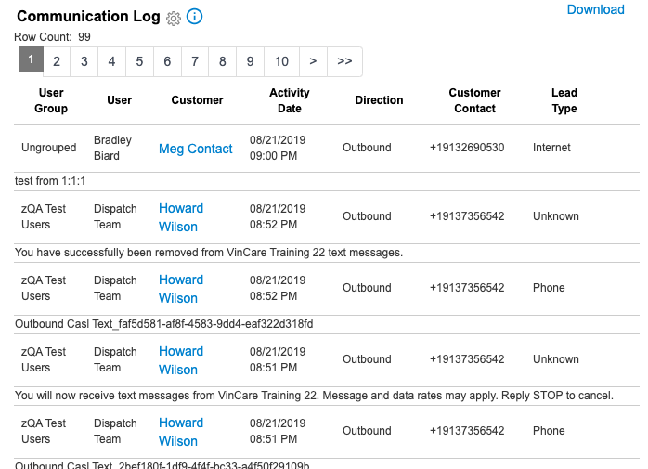
Communication Log
Notes:
Keep it conversational, 1-2 sentences
Give them a reason to text back.
Text messages stay in the voice/ customer experience you want?
Are you looking at communication log to see the quality of the outbound texting?
How many listen to incoming sales calls? We had dealers request all communication be in the same place as opposed to different reports for logged calls, e-mails & text messages. Here it is.

Slide 30
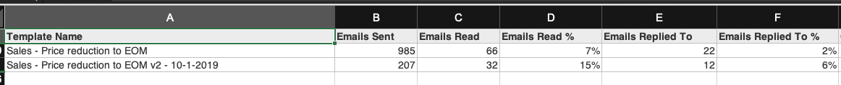
8% Increase in Read Rate
4% Increase in Replied To Rate
Notes:
Here’s an example of a dealer who did the AB Testing with their Templates. Now, this only went live October 1.

Slide 31
Profile Manager
Notes:
Hopefully I’ve got your blood boiling to see where there’s areas of opportunities. I showed you where texting can be recognized as a way to stop a lead by several OEM’s – but let’s dive into texting a little more.
I’m not trying to sell you something, but if you don’t have texting, sorry you are sitting through it. We have 2 products, MMS & SMS.

Slide 32
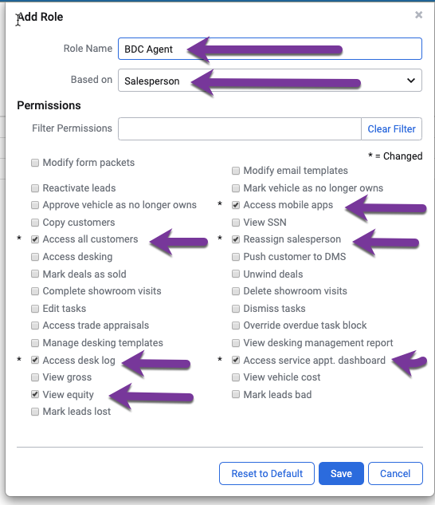
BDC Profile Manager
Settings – Users – Profile Manager
Notes:
With our new granular permissions, you are able to set up a real “BDC Manager Role”.

Slide 33
Texting
Notes:
Hopefully I’ve got your blood boiling to see where there’s areas of opportunities. I showed you where texting can be recognized as a way to stop a lead by several OEM’s – but let’s dive into texting a little more.
I’m not trying to sell you something, but if you don’t have texting, sorry you are sitting through it. We have 2 products, MMS & SMS.

Slide 34


SMS v E-Mail
SMS Open Rate is 98%
It takes someone 90 seconds to reply to a text.
It takes someone 90 minutes to reply to an e-mail.
E-Mail Open Rate is 20%
*Campaign Monitor ROI Showdown: SMS Marketing v E-Mail Marketing, January 18, 2019 https://www.campaignmonitor.com/blog/email-marketing/2019/01/roi-showdown-sms-marketing-vs-email-marketing/
Notes:
https://www.campaignmonitor.com/blog/email-marketing/2019/01/roi-showdown-sms-marketing-vs-email-marketing/
Toyota, BMW, JLR, Subaru, Audi, VW, Mitsubishi, Volvo, Hyundai, Kia, GM
Do you pay attention to the customer dashboard? It burns me up when I look at a customer dashboard & I see they sent an email, the customer read it 3 times & then there’s phone calls with “LM” after that. They’re opening the e-mails KEEP E-MAILING THEM!
Try all ways to contact a customer.

Slide 35
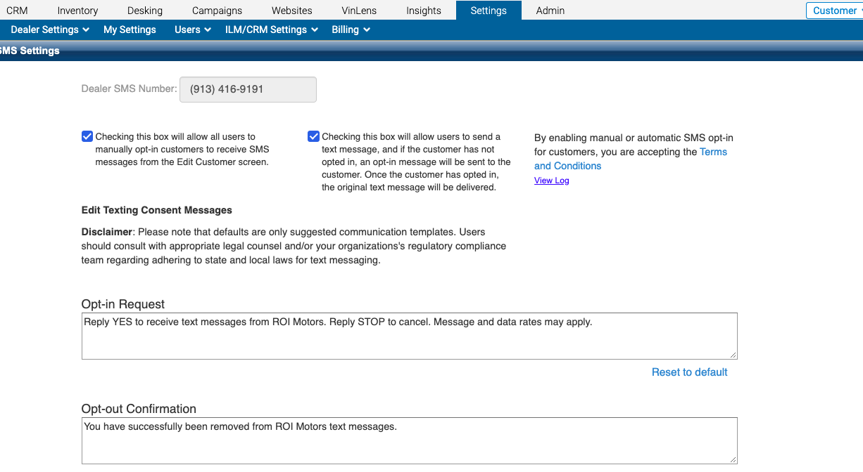
Notes:
You asked, we listened – we had dealers ask to be able customize the opt in request/ opt out confirmation.
Settings – Dealer Settings – SMS Settings

Slide 36
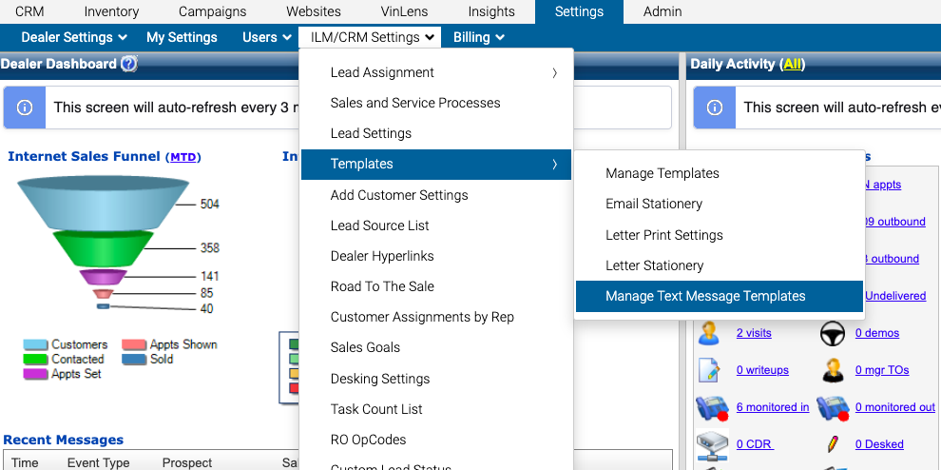
Notes:
Enhancements – feature requests – texting templates was one for a long time. We listened to you.
Settings – ILM/CRM Settings – Templates – Manage Text Message Templates Only available with MMS

Slide 37
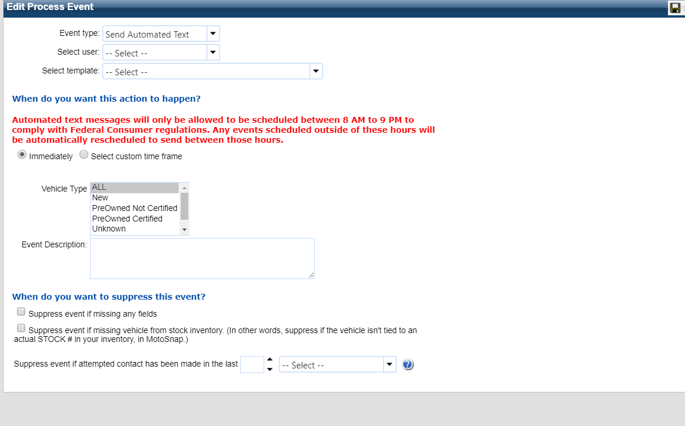
Texting In The Processes
Notes:
Now that we have templates set up, You can text in the processes with auto text messages and text message tasks. When to auto text v when to use text task
You have to select a template, when you create an auto text or a text task.
Drop a google maps link in your text message template and then drop it into the appointment confirmation auto text message 24 hours before.
Again – only available with MMS

Slide 38
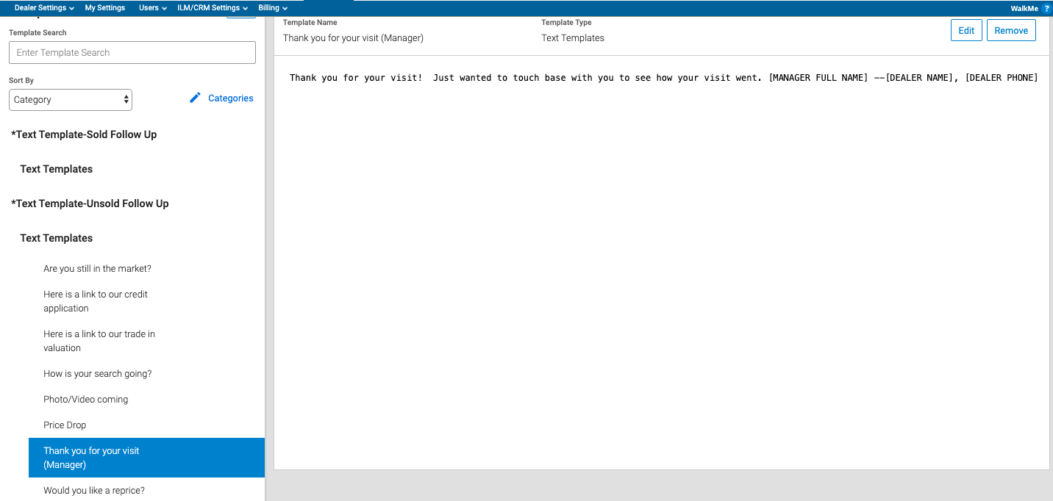
Notes:
There are 30+ templates that we have put together. If you don’t’ have them, reach out to your PM to get them pushed out to you.

Slide 39






But which processes?
Notes:
You can only drop auto text messages/text message tasks into certain processes. They are:
New internet lead
Phone process
Sales appointment reminder
Missed appointment
Custom
Showroom Visit

Slide 40

Did you know?
Notes:
How many of you have seen the commercial with jake from state farm? Where he’s talking to people at all hours of the night.
Something we’ve added – we don’t want texts going out at 2:00 AM and making angry customers.
8:00 AM – 9:00 PM to comply with federal regs.
If any text message is scheduled to fire aside from this time, it will automatically be rescheduled. So don’t worry about texting people at 2:00 AM.

Slide 41
Takeaways
Notes:
When you came in here, you came in here to find out how to Shapeshift your BDC. We’ve given you some steps on how to do that.

Slide 42
Takeaways
Inspect
Dashboard
Process
Update
Templates
Schedule
Measure
ROI
GROSS
Notes:
So – in closing.
Inspect what you currently have – look at your dashboard when you first log in. Look at your processes. Do they align with your goals?
Update your templates, look at the E-Mail Template Performance Report, are your most frequently used processes getting read? Look at Lead Source Performance – does your BDC’s schedule reflect your heaviest lead volume times?
Measure – measure your ROI now & your ROI after you make these adjustments. Measure you gross.

Slide 43
QUESTIONS?

