Slide 2
Regeneration in your Service Department
Mike Vannattan
Performance Manager

Slide 3
Agenda
Sales to Service
Service to Sales
Texting Utilization
Service Appointment’s
Service Campaigns
Q&A

Slide 4
Sales to Service

Slide 5
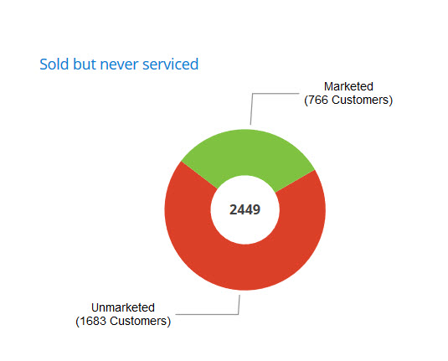
Missed Opportunities
How many of YOUR customers buy, but never service with you?

Slide 6
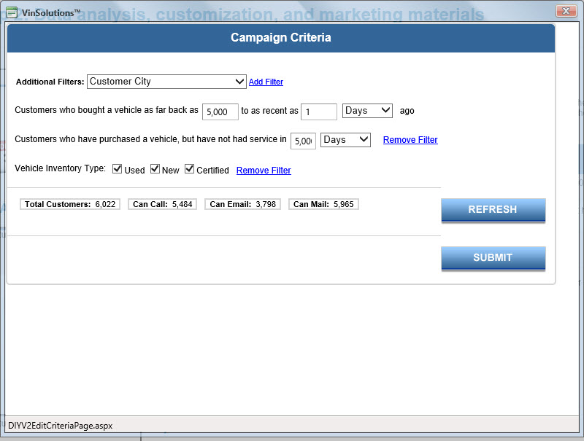
Missed Opportunities

Slide 7
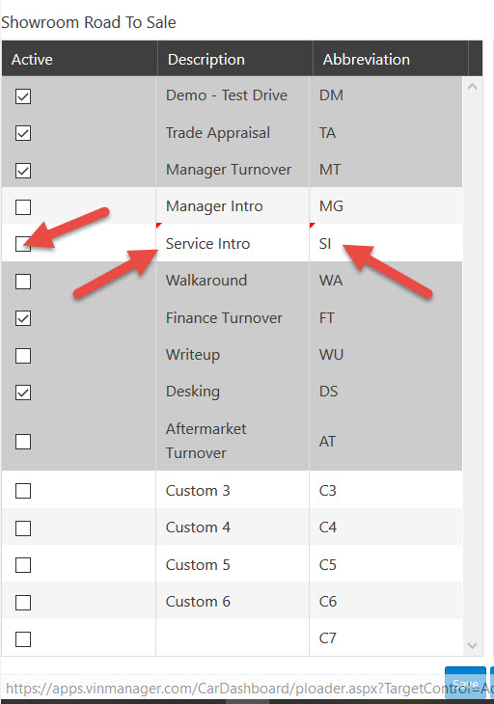
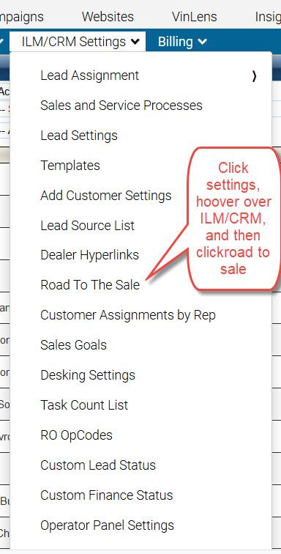
Service Intro in the Road to Sale Process

Slide 8
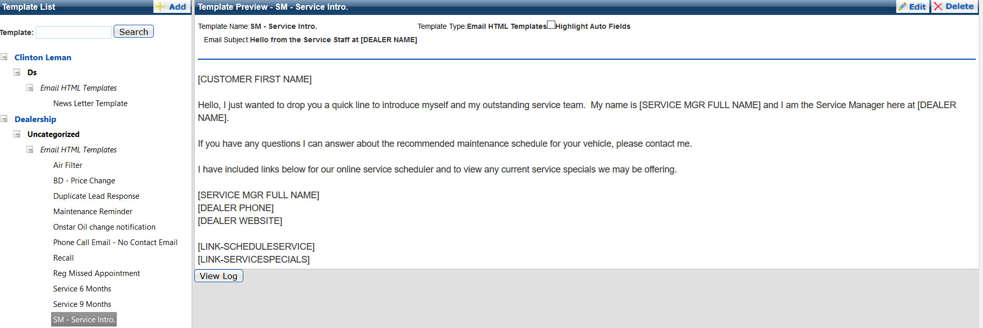
Service Manager Follow Up

Slide 9
Make Sure Your Customers Know
We Service All Makes and Models
(BOTH NEW,USED & CERTIFIED VEHICLES)

Slide 10
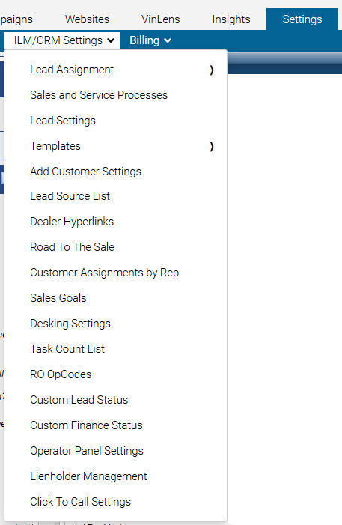
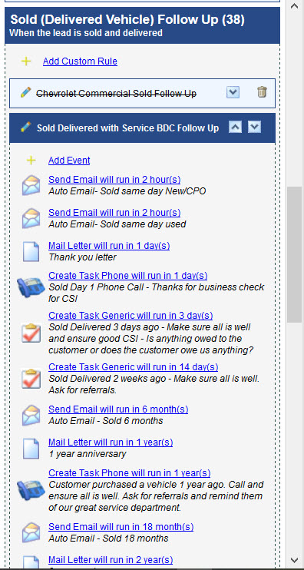
Continue to Follow Up
First Oil change in sold follow up process, maybe 1 year, 2 years, and 3 years etc….

Slide 11
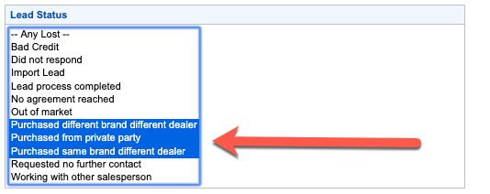
Unsold Service Follow Up
Purchased Elsewhere – Are we trying to reach these customers for future growth and retention?

Slide 12
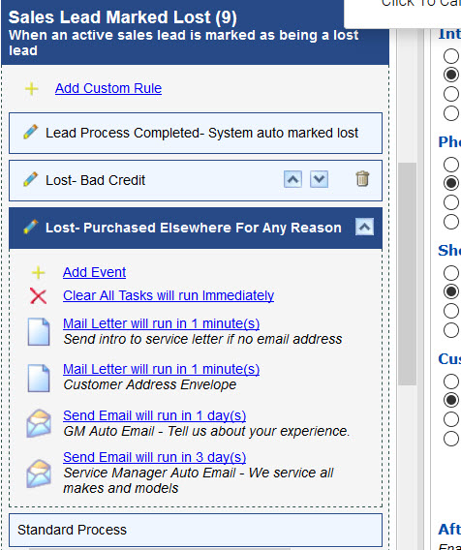
Follow up with ALL opportunities
Create your own follow up process to capture new service customers, regardless where they purchased

Slide 13
Service to Sales

Slide 14
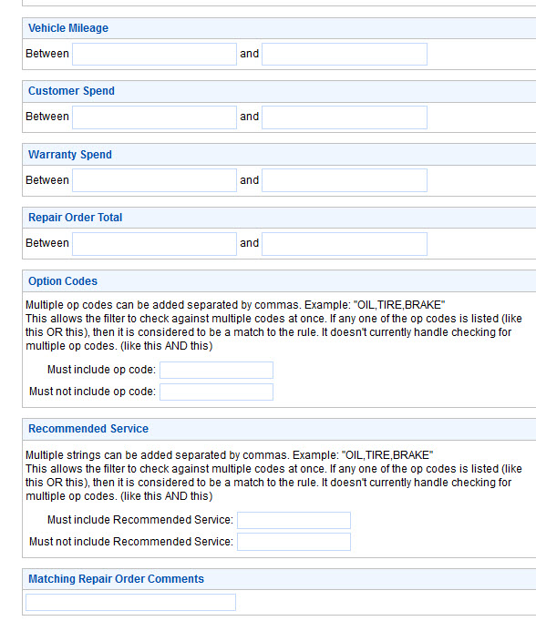
Closed RO’s
What are you currently doing?

Slide 15
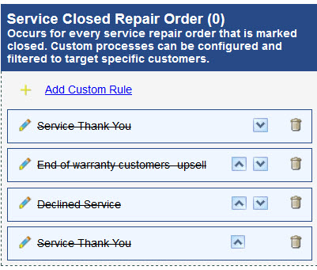
Declined Big Ticket RO’s

Slide 16
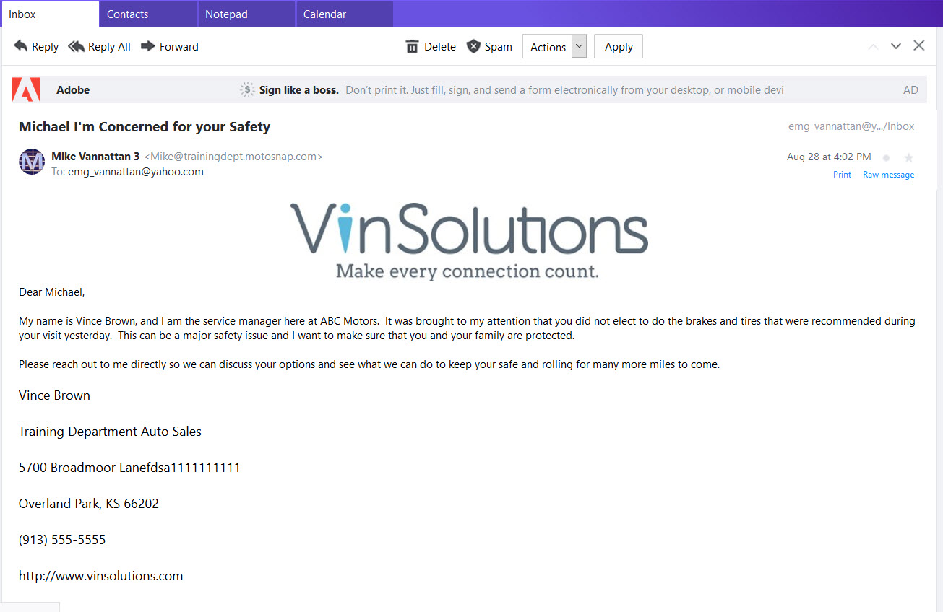
Declined op codes

Slide 17
Declined op codes

Slide 18
F&I
Utilize Mileage - did you buy a warranty?
Utilize op codes - did you buy tire & wheel, paint protection, etc…

Slide 19
Texting Utilization

Slide 20
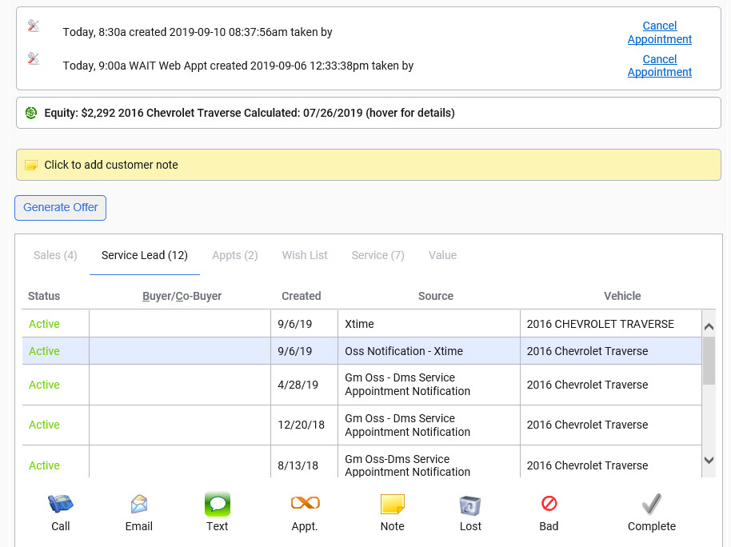
Easy to use

Slide 21
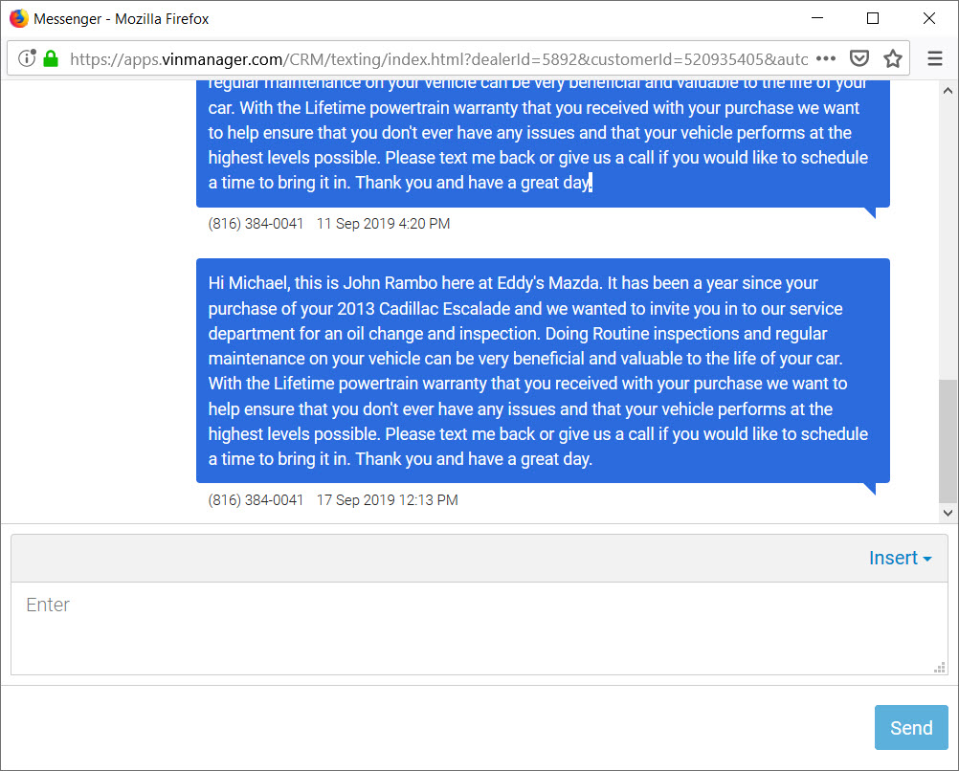
Quick Communication

Slide 22
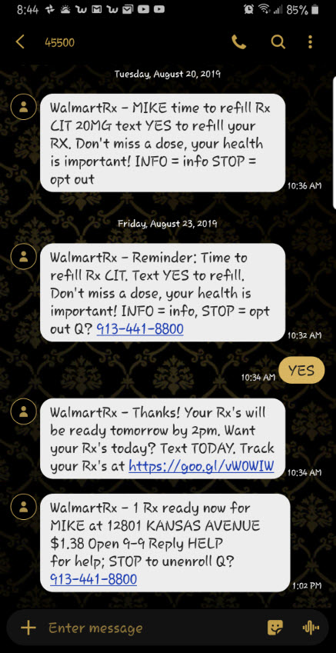
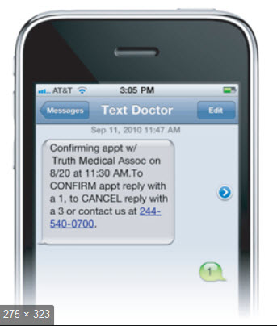
Texting Utilization in Service ideas
Appt. Reminder
Your car is ready
Multi Point Inspection Video

Slide 23
Service Appointment’s Integration with DealerTrack, Reynolds, CDK, Dominion, Autosoft, Adam, PBS, Procede, & Serti

Slide 24
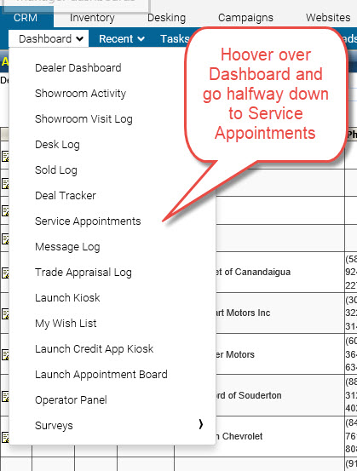
Be Proactive with Service Appointment’s

Slide 25
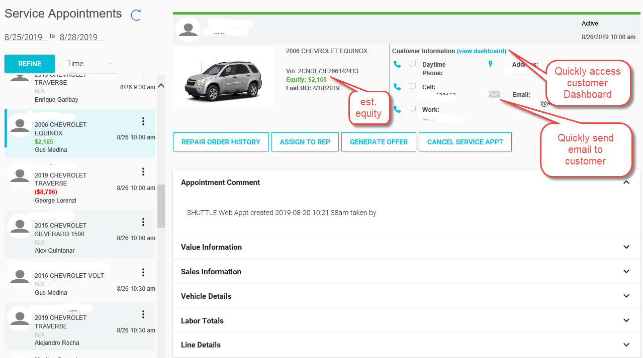
Service Appointment Dashboard

Slide 26
Enhance Your Customer Experience
Sales people are aware of their customers coming in for service

Slide 27
Service Campaigns

Slide 28
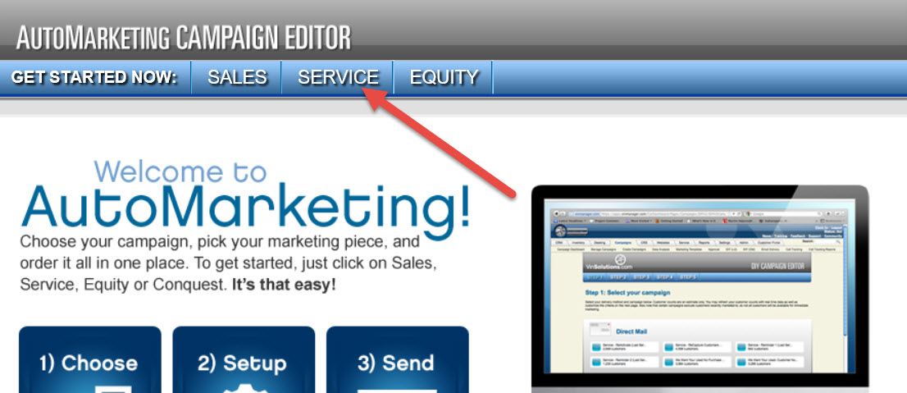
Campaign to your customer’s

Slide 29
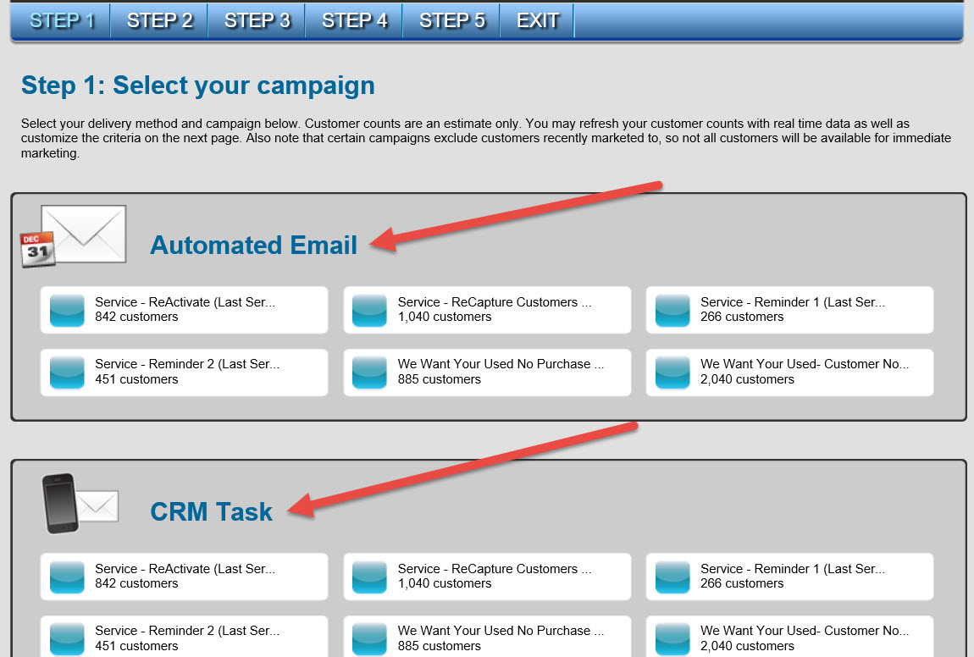
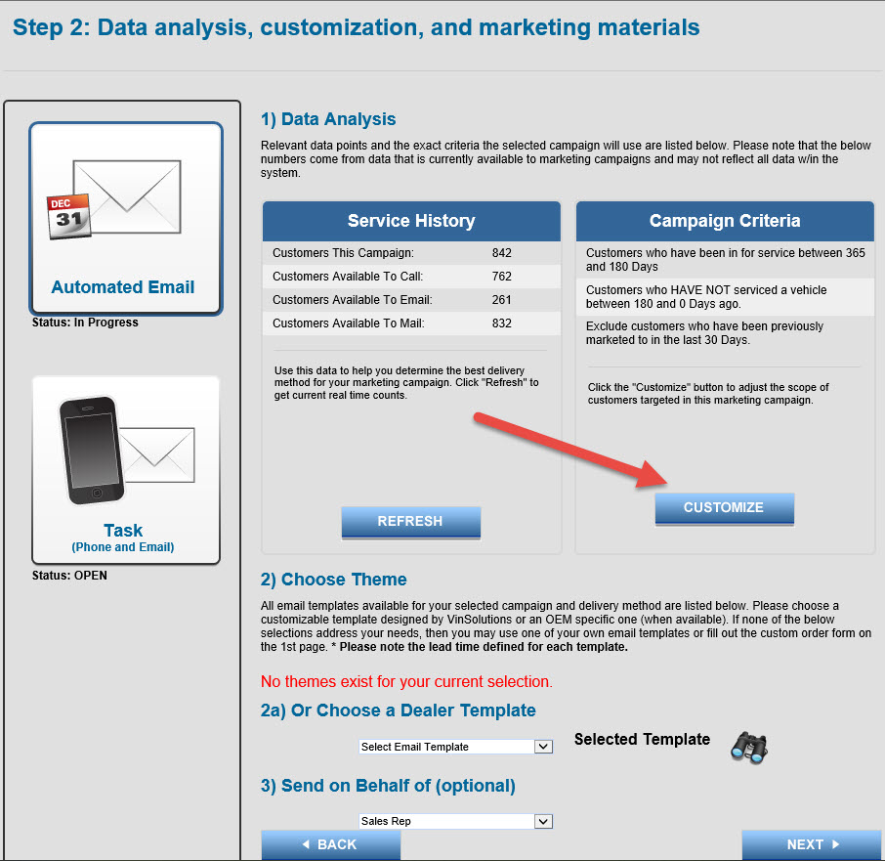
Custom Campaigns

Slide 30
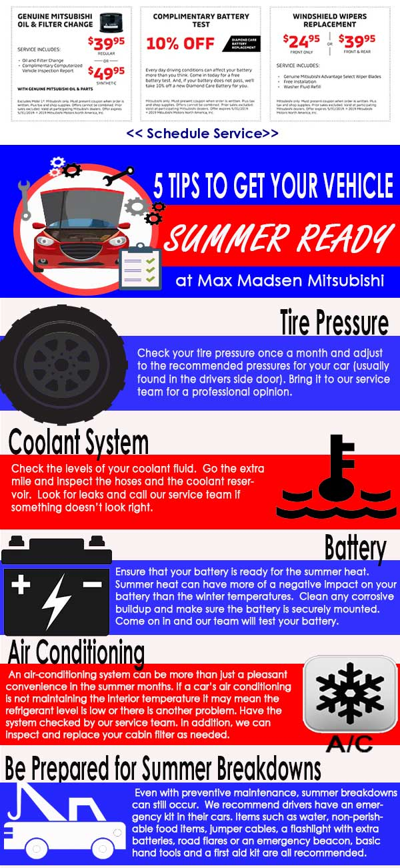
Campaign Examples

Slide 31
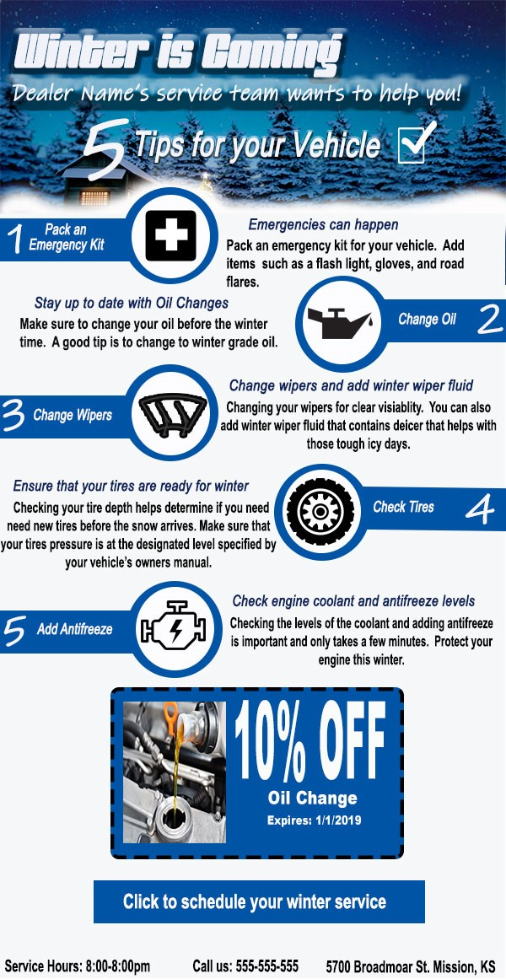
Campaign Examples

Slide 32
Campaign Examples

Slide 33
Key Takeaways
Sales to Service/Service to Sales game plan
Additional profit from closed RO’s
Utilize Texting to communicate
Be more effective on your service drive with the appointment dashboard
Campaign to regenerate and retain opportunities
Utilize your Vinsolutions CRM to improve CSI and add money to your bottom line

Slide 34
Q&A

Slide 35
Regeneration in your Service Department
Mike Vannattan
Performance Manager

