Slide 2
Bobby Holmes Senior Performance Manager

Slide 3
Harness the Power of “Invisible” Manager Duties
Uncover hidden opportunities with Connect CRM and lead your team to success.

Slide 4
Agenda
What will we cover today?
Buttonology v. Dealership Growth
Manager Duties “Keys To Success”
The Ultimate Power Play (WIFM)
Q&A

Slide 5
Buttonology vs. Dealership Growth

Slide 6
Buttonology vs. Dealership Growth
What is Buttonology
- The Art or Practice of clicking buttons to trigger an action or to make tasks Go Away.
What is Dealership Growth
- Practice of collecting information for use in making educated decisions that increase units sold and grosses.
What does this Daily Execution look like?
- Let’s now discuss this as it pertains to your Time Investment
Notes:
What is Buttonology (B)
The Art or Practice of clicking buttons to trigger an action or to make tasks Go Away.
What is Dealership Growth (DG)
Practice of collecting information for use in making educated decisions that increase units sold and grosses.

Slide 7
My Time Investment?
What should I be looking at and when?
Basically (ACTIVITY)
Activity Breeds Activity
Everyday
Ask your self this:
If you cannot see it, does it even exist?
If it is not in the CRM then it did not happen!!!

Slide 8
Do they match?
Let’s briefly discuss a few assumptive items….
Internal Sales Process
What you want to happen
CRM Processes
What the CRM is
sending to the Users
Notes:
Internal Process:
Important that all staff completes
Not Negotiable
CRM Processes:
What the CRM is telling you staff to do
Does it match your Internal Process

Slide 9
Process vs. CRM Processes
Does your staff know what is going to happen next?
Is it IMPORTANT?
Know what is expected
This all works together for holding our staff accountable
Creates a Good Customer Experience
Notes:
#1 Is it IMPORTANT?
Are the events in you processes important to you that the steps need to be completed 100% of the time. If not then modify you process
#2 Know what is expected
Does you sales staff know what your processes are doing. This includes sales people, BDC and managers.
Question to Room: Who in here has 100% of their sales teams that know you Internal Road?
Does your Internal RTTS and CRM Processes… Do they Match? (if the answer is no then “Why Not”)
#3 This all works together for holding your staff accountable
#4 Creates a Good Customer Experience
Question to the Room:
That Internal Sales Process you have…
Did you create that process just to have your staff do busy work or because you know it works and creates the Experience you know the customer wants?
Scenerio: Is doing a Test Drive part of your Internal RTTS?
Would you let any on your staff just choose not to do it, Of Course Not….
Your Internal Sale Process is not negotiable because you know and believe it works, right?

Slide 10
Manager Duties (Keys to Success)

Slide 11
Keys to Success at a Glance
What are they?
- Often referred to as “The Daily Duties”
- The most important items that WILL impact your Sales / Customer Experience
Who should be doing these?
All Managers – Manager Daily Duties
Salespeople – Salesperson’s Daily Duties

Slide 12
Keys to Success
Manager’s Keys To Success
Salespeople and Manager Tasks are completed
Appointments
Showroom Visits (Accurately & Timely)
Update Sold Log Every Night
DMS to CRM Sales/Customer Matching
Unanswered Emails and Text Messages
Active Leads without Future Follow Up - Sales
Notes:
We will go through this in-depth shortly
#1 Take it back with you and make sure that ALL of your managers have this on their desk

Slide 13
Keys to Success
Salesperson’s Keys To Success
Enter 100% of customers into the CRM
Complete all your tasks
Review and complete alerts on your dashboard
Set your Appointments in the CRM
Log Showroom Visits for ALL customers!
Prospect in your Leads Page
Utilize your Wishlist
Notes:
This list is a SP version that fits inline with the Manager Daily Duties List.
#1 Take it back with you and make sure that ALL of your salespeople have this on their desk

Slide 14
“Just Do It…”
Notes:
Who in here does not know who your Performance Manager is? *** Everyone Should ***
We are not going to talk about the Manager daily Duties in here in the “Just Do It….” Do It fashion.
We are going to discuss them in and set the proper expectations:
What we need to be looking at
Why we need to be looking at these things
What negative ramifications will come up by not getting these things completed
Does That Make Sense to everyone??? Excellent, Let’s dive right in…

Slide 15
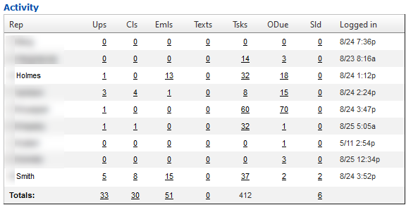
Completing Tasks
CRM > Dashboard > Dealer Dashboard
Notes:
#1 – Locate the Activity Section of the Main Manager Dashboard
#2a – Overdue Tasks
Q. How long does it take for a task to go overdue in the CRM?
A. 36 Hours
#2b – Q. Do you think the number of over due task for this user (Mr. Holmes) is 18 over due tasks or 18 Customer with tasks.
A. It is actually 18 Customers with overdue tasks. So this means, Mr. Holmes has 18 customer that have not been followed up with in at least the past 36 hours.
!!! Do you think that it is important that you are communicating with your customers??? Does that make anyone’s blood boil just a bit???
#3. The next important part of this section that we are looking at now is the Activities. We need to make sure that our guys are living in the Activities.
These 3 column show total inbound and outbound activities for each of these.
Situation #1: If it is early in the morning or my guys just came in I am not concerned about little activity but…
Situation #2. If it is 4 o’clock in the afternoon and my guys have been here all day, who would agrees that Mr. Holmes only having 13 total emails (no calls and no texts) all day is a BIG problem?
Q. Who in here thinks this might be costing you at least one car deal because your guys are sitting around waiting for the up bus?

Slide 16
Cause
Managers Have A Lot of Overdue Tasks
Effect
Tasks aren’t Important or going to the wrong person / We lose deals in the clutter
Cause
Staff Aren't Logging Activities
Effect
Tasks aren't relevant/ going to the wrong person
Think About It: How much money is this truly costing you?
Notes:
#1 First; Manager’s… We need to manage by example, you cannot expect that your salespeople will do what you yourselves are not willing to do.
Let me ask you managers a question,
Lost task being done,
if not creating clutter
Task not valid to manager or Salespeople because of clutter
Active Customers – Showroom Visit Followup
Getting Lost
Costing CarDeals
#2 Tie back to the LOST SITUATION and Salespeople Checking OUT
Let me ask a question: Have you ever gotten a bad review?
Because of NOT following up
Where you really surprised when you got it?
You should have see it coming and known that it was coming
Note:
If tasks are CRM processes problem (which it might be)
then go fix your process and make sure it is what you expect (like we talked about earlier).
So, Think About It: How much money is this truly costing you and your dealership by not staying on top of tasks?

Slide 17
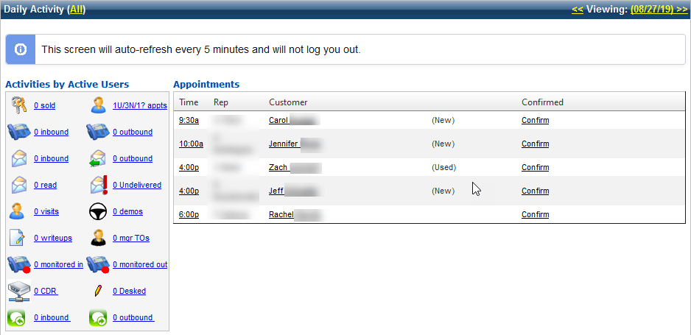
Appointments
CRM > Dashboard > Dealer Dashboard
Notes:
The next area of living in the Activities is managing appointments properly.
#1: Let me see a show of hands, who believes that Appointments create Sales opportunities?
With that being said, Let’s discuss why it is IMPORTANT that we set and make sure that all appointments are in the CRM.
Most important it puts the customer in the correct follow up
reminding customers about their appt
making sure that task are relevant.
Putting the Appts in the CRM triggers and controls how the system will task us to communicate
right message and at the right time with our customers.
Let me ask a question:
ever seen a sales rep or customer upset because we are still following up on them being interested in a car when they supposedly have an appointment with someone and *cough* the appt was not in the CRM??? ***
Happens more than it should and we wouldn’t have these problems if the appts were in the CRM ***
know accurately how many appts you have
who does and does not have appts.
Show of hands, who in here has asked your sales staff (in your morning meetings)
who has an appt today and a lot of hands go up
Who has those appts in the CRM?
#2: Another Key area of Manager responsibilities is to Confirm Appts.
If appts are not in the CRM, Can you possibly know about ALL appointments scheduled?
Can you confirm appts that you don’t know about?
Confirming Appts will also allow us to know things like:
what are real appts or not (SP logging fake or non-committed / wishy washy appts to look good on a report)
what customer’s have actually been solid confirmed.
Let me ask a question,
Who would agree that confirming appts is important and
that confirmed appts show up more than unconfirmed appts?

Slide 18
Cause
Not Setting Appointments In The CRM
Effect
Incorrect or No Message / Not Setup for Success
Cause
Not Confirming Appointments
Effect
Appts Not Valid / Employee Retention
Think About It: How many customers are slipping away?
Notes:
#1 After Listing Effects
These are common situation when the appts are not in the CRM, like we just discussed.
Having them in the CRM controls the
right message at the right time with the customer.
Turning of the current follow up (such as killing my internet process).
Starting the appt reminder process (this gives me multiple options)
not just an email or just a phone call,
but combination of all calls, emails and text messages).
If the customer does not show up then I can follow up with the correct message about getting rescheduled to come in.
#2 After Effects
Confirming appts is more than just clicking the confirm button.
Actually solid confirming appts allows you to take control and
make sure we are communicating in the best way (with customers to get them into our dealership)
When we find INVALID APPTS, we can cancel them out and then make sure the customer is in a custom follow up process that makes since (such as a re-engage customer process).
Confirming appts allows us
help our sales staff with the customer communications a
about their upcoming appt and
really being effective at getting them to show.
a manager voice/title can be enough to sway the customer to coming in.
When more customers are showing up, then we are
selling more cars,
which means we have much
happier sales people to.
So, Think About it: How many customers are slipping away because appts are not making it into the CRM?

Slide 19
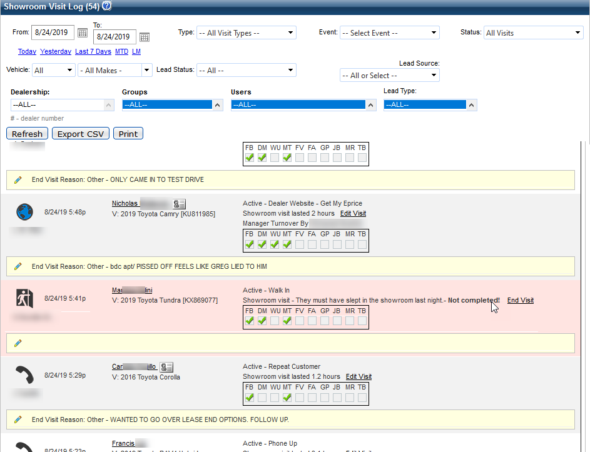
Showroom Visits
CRM > Dashboard > Showroom Visit Log (Starting a Visit)
Notes:
Logging and controlling Showroom visits is extremely important.
logging showroom visits (and actually putting the customer on the floor) controls everything:
while they are here and
once they leave.
As managers we should be living in the Showroom Visit Log screen all day.
So lets talk about visits real quick: When a showroom visit is started:
Q. Let me ask a question: Who should be starting the showroom visit?
Best practice is to have the salespeople do it when the customer hits the lot (not just when they come inside), that way we see all customers on the floor, not just the ones that hit the desk).
Quick Customer Story: MY Mazda Service (no sales lot experience)
Q. What happens to that appt that we have scheduled?
A. When the visit is started it will automatically complete the appt and take it off the appt log.
Q. If a showroom visit is not started, Can you close it out / End the showroom Visit? A. NO

Slide 20
Showroom Visits
CRM > Dashboard > Showroom Visit Log (Ending a Visit)
Notes:
So lets talk about when a showroom visit is ended:
Q. When should we end a showroom visit? A. In real time (Why? So when that customer leaves and continues shopping, we can promptly follow up instead of following up at the end of the day or the next day – when the customer now has their brand new car from another dealership sitting in their driveway. Oops We lost). Q. When is what happened during the visit fresh on our mind? A. Right at the end of the visit. Collecting the information accurately 100% of the time and being selfish about it is crucial to growing your dealership sales).
Q. Isn’t important to note, Did the customer buy or not and follow up correctly?
A. Absolutely it is….but If we do not tell the CRM at the end of the visit whether they bought or not, then we cannot control that next message about their new car they just purchased….

Slide 21
Showroom Visits
CRM > Dashboard > Showroom Visit Log (A Few New Enhancements)
Notes:
I want to quickly point out couple of improvements recently made to the Showroom Visit Log that takes it to the next level.
1) Status Drop Down (shows)
Open Visits Only
Closed Visits Only
All Visits
2) The pencil on all notes:
This is critical as it allows you to edit and add notes as the visit is happening instead of waiting hours for the visit to end and then trying to remember what happened.
3) On the Road To The Sale items, all items can be checked off in real time as they are happening.
4) The ability to fire directly out to Desking and the Credit App Kiosk were added
These were all improvements that brought better operation of the showroom management into one area of the system….

Slide 22
Cause
Not Starting a Visit
Effect
Incorrect Message / Reporting
Cause
Not Ending A Visit
Effect
No Message or Follow Up / Losing deals and Future Ops / Bad Customer Experience
Think About It: Aren’t Be-Backs Important and Profitable?
Notes:
#1 When we do not start showroom visits we end up with poor messaging to the customer such as:
We do not get the appt completed (and we end up following up about missing an appt when they were here)
No Follow up can be started after the visit because you cannot end what doesn’t exist.
You have no record of the customer being here which skews all your reporting.
You also lose valuable information for prospecting later and for coaching your salespeople on how to be better.
#2 When we do not end showroom visits we end up with many negative things happening
Customers end up getting no follow up after they leave the dealership
Because we have no follow up we end up finding out later that the customer bought from someone else because we never follow up timely.
We end up not collecting information about the customers visit and situation (so we cannot use any of the details later when we need it for prospecting and coaching).
We do not get customer’s marked as sold when they do buy. This creates a poor after the sale experience and can lead to getting poor reviews.
If a visit is still open then we cannot log be-back visits (which ends up being missing visits being logged and more incorrect or no messaging after the be-back visit).
Think About It: Aren’t Be-Backs Important and Profitable?

Slide 23
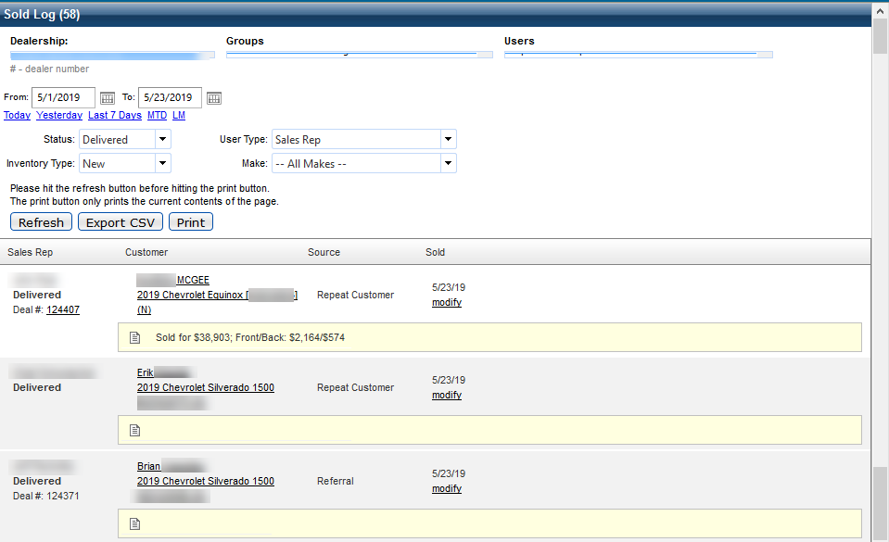
Sold Log
CRM > Dashboard > Sold Log
Notes:
Maintaining the Sold log is very important for multiple reasons:
Deals marked as sold pending, on order or delivered are all displayed and control reporting and also follow up with the customer.
Are you marking deals as Pending? Why Not?
You should be marking deals as Pending Finance or On Order when you are in situations like:
Deposits Taken
In the process of locating a vehicle
Or if you have a car ordered with the manufacture for a customer.
By placing cars on order you will stop incorrect follow up on customers that are truly in a pending state.
Also you should add and update notes on all pending deals as you have more info about the deal.
Are you marking deals as Delivered and doing it promptly?
Delivered deals show in 3 different states of delivered
Delivered with No Deal Number.
This indicates that the deal was marked delivered manually
This deal is not fully completed yet.
Delivered with a Deal Number (that is not underlined)
This indicates that the deal was marked delivered manually
This deal is not fully completed yet.
You have a deal# that was entered and it can be used to cross reference the DMS for more info not finalized.
Delivered with an Underlined Deal Number
This indicates that you have a fully booked out and finalized deal with complete F&I information
A big reason for staying on top of the Sold Log daily is to ensure that Pending Deals are marked delivered as soon as they are burning gas.
Marking deals delivered controls prompt follow up with the customer about their sale
Also when deals fall through or if you have duplicated leads marked sold you can stay on top of these
Not doing this can lead to very bad situations…

Slide 24
Cause
Deals Are Not Being Marked As Delivered
Effect
Your Sold Customers are not being followed up with timely
Cause
F&I Details are not being attached to deals
Effect
Inaccurate Reporting
Think About It: Aren’t Be-Backs Important and Profitable?
Notes:
#1 Show Cause: Deals are not being marked Delivered.
Show Effects: a. Your Sold Customers are not being followed up with timely.
If you are marking deals as Pending and not reviewing them to ensure that they are updated to delivered when they are burning gas then you end up not following up with customers on the sale of the car.
Marking a deal delivered starts the follow up with the customer and should always be done promptly. Do not wait for the DMS to update as this might not happen if a mismatch in information happens through F&I.
If deals are not mark sold (pending or delivered) then you end up still following up with customers about being interested in purchasing when they already have bought from you.
If you are not following up or following up with the wrong message then this can lead to bad reviews and even bad surveys.
#2 Show Cause: F&I Details are not being attached to deals.
Show Effects: a. Inaccurate Reporting
If you do not have the front and back gross information entered on deals this affects reporting in a very negative way.
a. Some reports of note that are affected are:
ROI Reporting
Any custom reports with Grosses
If duplicated Sold records are on the sold log then you will be double counting sales
If deals are not marked sold delivered then you could be excluding them from any report that is reporting on delivered deals only.
So, Think About It: Are you giving your leadership team inaccurate information?

Slide 25
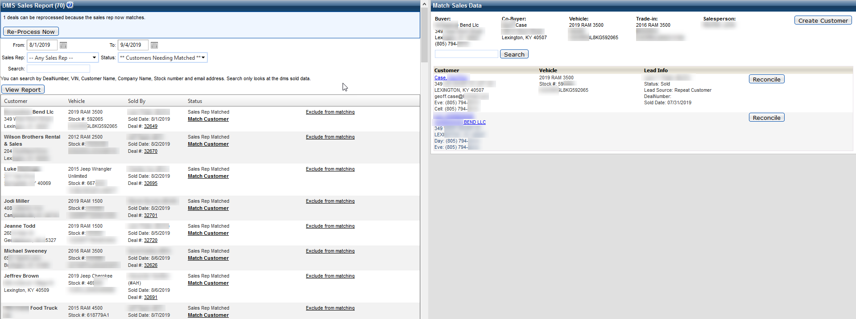
DMS to CRM Matching
Insights > DMS to CRM Sales/Customer Matching
Notes:
Now that we have updated our Sold Log for the day, you will still have questions.
That brings us to the DMS to CRM Sales Customer Matching report. What is this report and why should I be looking at it…
This is a mismatched Finalized sale screen
Not every deal that you do will go all the way through from the Desk thru F&I without any changes. (actually roughly 25% to 50% of deals have something major change on the deal)
Things that typically change that cause a mis-match are:
You swap the car to a different vehicle (customer wants a different option of color)
You swap or change the buyer / co-buyer on the deal (so it can get approved).
This is one area that sets VinSolutions atop the rest as we don’t ever assume the buyer in F&I is the actual owner when there is a mis-match. We put that information in front of you to make the human connection to ensure it is 100% correct.
So knowing that, this is a major piece of the puzzle in getting things correct in the CRM. Just because someone is the buyer on the deal in F&I does not mean that they are in possession of the vehicle “The actual owner”.
Story: A few years back I bought my wife a brand new car, during the process at the dealership, I told the Salesperson to put her in the CRM as the buyer (I was just there to facilitate the purchasing of the car because she had bad credit). He said he could not do that…blah blah blah, whatever. So we went all the way through the process and the deal went through F&I and auto matched up to me. Fast forward a couple years, I am now divorced and she still owns the car:
Who do you thing the dealership is following up with in regards to the car? ME
Who do you think could care less about car: Right, ME!!!
So important things to note:
This area of the system is not fun or sexy
It ties to the Sold log being 100% accurate
Which in turn controls making sure that all your reports are accurate
And last but not least, ensuring that the Financial information is correctly associated to the proper lead and buyer in the CRM, control the right messaging to the right person at the right time.

Slide 26
Cause
Don’t have time.
Effect
Inaccurate Sold Log Reporting Inaccurate ROI / No Equity Calculations / Missing Customers
Think About It: Are you communicating with the correct owner/driver of the vehicle?
Notes:
#1 Show Cause: We don’t have time to do this!!!
Show Effects: a. Missing Customers b. Inaccurate Sold Log Reporting c. Inaccurate ROI d. No Equity Calculations
If you are not spending a little time each and making sure that this information is matched up to your sold leads in the CRM, then you will end up in a bunch of bad situation. If any deals are in here then you do not have the financial information complete in your CRM. So…
We just got done talking about the sold log and providing bad information to your leadership team. So make sure you are working this in conjunction with updating the Sold Log daily.
That makes all your reporting incorrect including: being able to track out your marketing spend and accurate ROI information
If you do not have your F&I information associated to your leads in the CRM, then you are missing vital equity information that you need to make deals (2 to 4 year from now) – That vehicle buy-back / trade up and out sweet spot.
And also, you very well could be (and probably are) missing customers and/or leads. This is very common in lease return situations.
But let me tell you another true story. A little while back I had one of my dealers call me and say “We sold this customer a car 5 years ago and they are not in the CRM, something is broken). I went in and searched all around the CRM in various ways and also could not find the customer. So I went into the DMS to CRM customer matching report and looked for the customer/deal number and low and behold it was sitting there from 5 years ago. Keep in mind this dealership had been on VinSolutions for many years prior. Come to find out that the salesperson and desk skipped using and putting the information in the CRM so when the deal came back it had nothing to match to. So….
Not only was their reporting off.
They did not have any equity information on the customer
And also had not been doing any sold follow up on this customer. Ever!!!
I hope that gives you an idea of how important this is. You will not have massive amounts of deals in here, most days you won’t have any. But when you do, get them matched up daily.
So, Think About It: Are you communicating with the correct owner/driver of the vehicle and or ensure you are following up period?

Slide 27
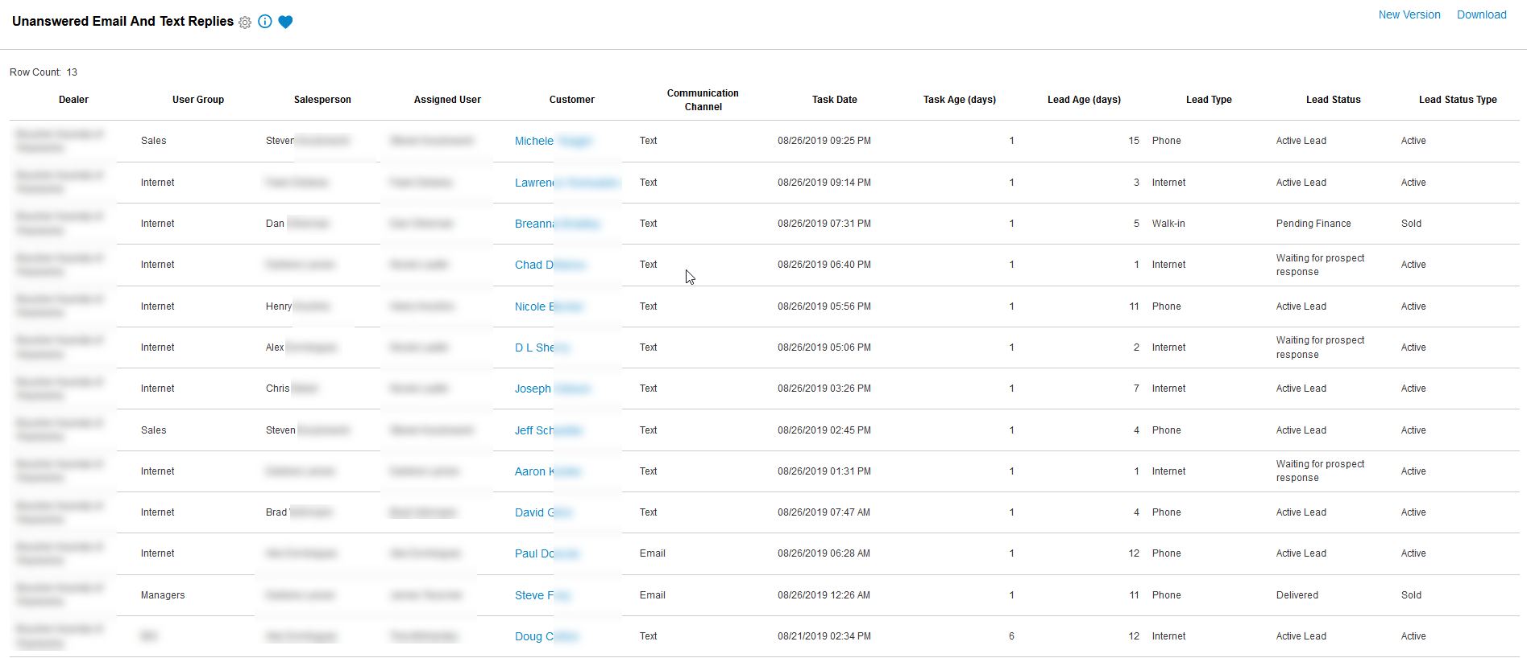
Unanswered Emails and Texts
Insights > Unanswered Email and Text Messages
Notes:
Next up is the Unanswered Email and Text Messages report.
This report will show you all emails and text messages that have not been responded to.
Let me ask a question:
Who thinks it is vital that we are control of conversations with customers and should be the last ones to communicate with them?
So some things that this report will show you quickly is:
#1 How many emails/text messages are unanswered.
#2 This column will show you how many days ago the message came in.
Is anyone in here a little bothered by the fact, that a customer texted us 6 days ago and we never replied…(show of hands)
All managers should have this favorited in you insights screen. You can also create a version of this and have it emailed out to you o a daily basis as well. So there is really no reason you should not be looking at this and holding your team accountable to making sure you are in control of customer conversations.

Slide 28
Cause
Customers are replying to managers and the tasks are being dismissed.
Effect
Customers feel like you don’t care Reputation Management
Cause
I have a person that always shows up on this report.
Effect
They aren’t utilizing the CRM to communicate with your customers
Think About It: If it isn’t happening in the CRM ________ !!!
Notes:
#1 Show Cause: Customers are replying to managers and the tasks are being dismissed.
Show Effects: a. Customers feel like you don’t care b. Reputation Management
Let me ask you a question: Your Dealer Rater / Website reviews and all those kind of things that your always looking at…
Does it matter to you if the customer gives you a BAD REVIEW?
Situational Story
When you see one of those customer pop up on here, 9 times out of 10, are you surprised. Or is it a name or situation that you recognized.
Not always but most of the time, customers will typically give you a chance to right a wrong situation.
If you have one of the automated emails going out from your GSM/GM or Owner that is all about asking the customer about their experience and did we help them, and they are rarely logging into the CRM, are we getting these responded to? If not then when you get that BAD REVIEW – Are you Surprised….. You missed the opportunity to right the situation. All the managers see this report, so there is no reason that emails like this should ever go unanswered.
Let me ask you another question (Let me see a show of hands).
Have you ever looked at customer record in the CRM and seen emails or text messages from a customer, actually telling you they want to spend money and the message goes unanswered?
Well it happens way more than you would like to believe. This is 100% costing you car deals and if you are looking at this report throughout the day. You can see it and catch it before you lose that deal.
#2 Show Cause: I have a person that always shows up on this report.
Show Effects: a. They aren’t utilizing the CRM to communicate with your customers
Let me ask you a question:
Is this message being responded to? *** Maybe ***
How do you know? *** You can’t unless you are CC’d on the email/text string ***
Is your dealership possibly at risk of opt in/out liability (especially with texting from personal devices)
So we talked earlier about accountability and knowing what is going on in your dealership and being in control of the customer experience.
So…. Think About It: If it isn’t happening in the CRM ________ !!!
Ask - Who wants to finish the statement???

Slide 29
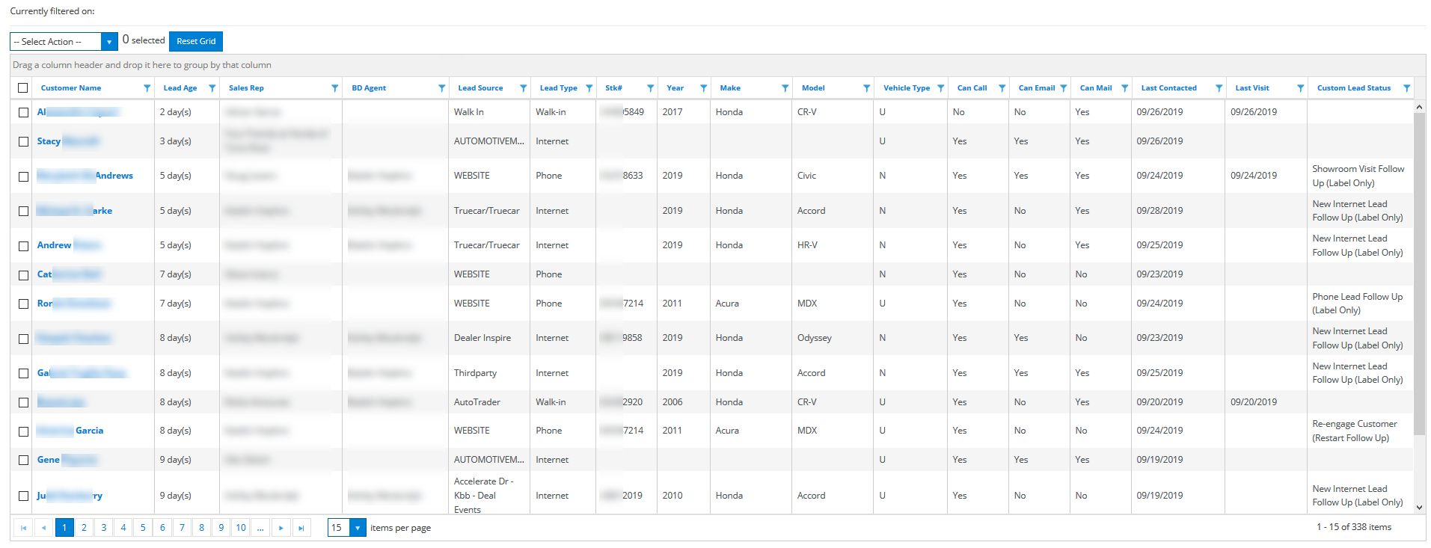
Active Leads without Future Follow Up - Sales
Insights > Active Leads without Future Follow Up - Sales
Notes:
Lastly, but certainly not least…. We are going to look at the Active Leads without Future Follow Up.
This report is critical in that these leads have fallen into what I like to call the BLACKHOLE…
These leads are still Active which means the customer has not bought yet or taken themselves out of the market.
When reviewing this I keep in mind that this report is a symptom of some other problems. In all likelihood you have some processes in your store that are not fully optimized.
Some reasons for things being in here can be:
My process ran out of events (such as, say I have a shorter process for my TrueCar leads that runs 20 days and this lead is 30 days old). What is next???
You have appointments that have either been cancelled or never got handled when the customer did not show (aka, appt did not get marked missed).
You could also have some process that is not configured properly to handle the leads in the best manner or
You have a process termination setting setup differently than what you are expecting.
Again, these are all symptoms to other problems. This should be viewed daily to look for why are the leads getting here and to do something with the leads that are here.
I will cover a couple of suggestions and situation for handling leads that are here.

Slide 30
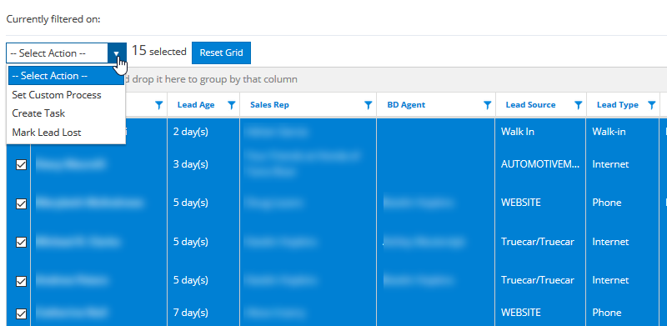
Active Leads without Future Follow Up - Sales
Insights > Active Leads without Future Follow Up - Sales
Notes:
You can highlight leads in bulk by checking the checkbox next to each.
In the select Action dropdown you have a series of things you can do.
You can drop them quickly into a custom process such as a re-engage customer process
You can create tasks or alerts for you sales people to handle these in a certain way or
You can mark leads lost in bulk (an example of this would be leads that are older than a year that have had no attempted contact in the last 30 days)
No matter what the situation, you should always determine what the root issue is and go after solving it. Doing an action is more of a Band-Aid on the situation.

Slide 31
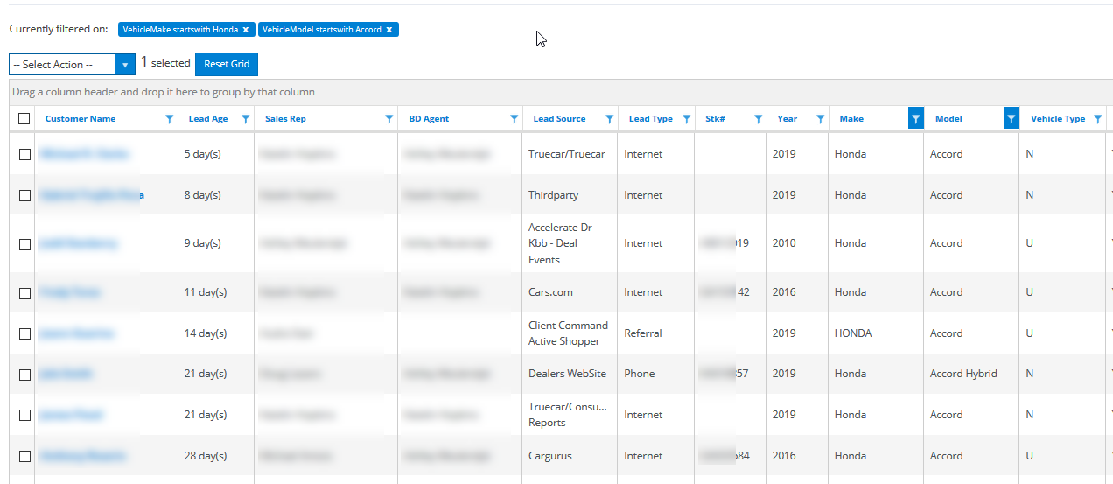
Active Leads without Future Follow Up - Sales
Insights > Active Leads without Future Follow Up - Sales
Notes:
Another common situation (especially if you have lots of leads on this list).
Say it is the end of the month, and you have some good incentives on Honda Accords. You can apply filter and look for all the Honda Accords and then fire off an email tasks to the sales rep to send out a certain email template.
This allows you to tackle a bigger problem with a pinpoint plan of attack.
Note: those leads will soon be back in here so you need to find out the root issue and solve it for a long term real fix.

Slide 32
Cause
Loss of Deals
Effect
Customer’s do not receive follow up Dissatisfied Employees
Think About It: Why are you wasting your marketing spend?
Notes:
#1 Show Cause: Loss of Deals
Show Effects: a. Customer’s do not receive follow up b. Dissatisfied Employees
So look and ask yourself these questions.
How long have these leads been in here?
What types of leads are here (Internet, Phone, Walk-in, Referral, and so on….)?
If I am using custom statuses and custom follow up, what was the last status they were in (this can be very telling as to why)?
These are all pieces that will help you draw intelligent conclusions.
If these active leads in the blackhole are not handled promptly then customers end up moving on…. This will cost loss of car deals and give you frustrate / dissatisfied employees.
You spend lots of money on a monthly basis to get leads for your staff to work so you can sell cars. Right?
If your leads are ending up here, should you figure out why and fix it….
Think About It: Why are you wasting your marketing spend? (Fix the issues and sell more cars)

Slide 33
The Ultimate Power Play ( What’s in it for ME )

Slide 34
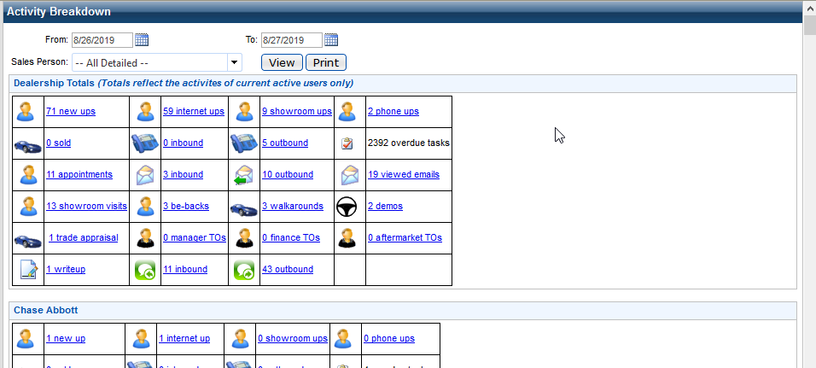
Activity Breakdown
Insights > Activity Breakdown

Slide 35
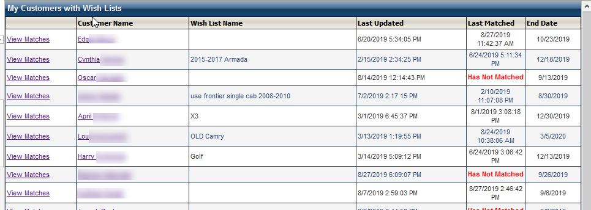
The Ultimate Power Play (WIFM)
CRM > Dashboard > My Wish List

Slide 36
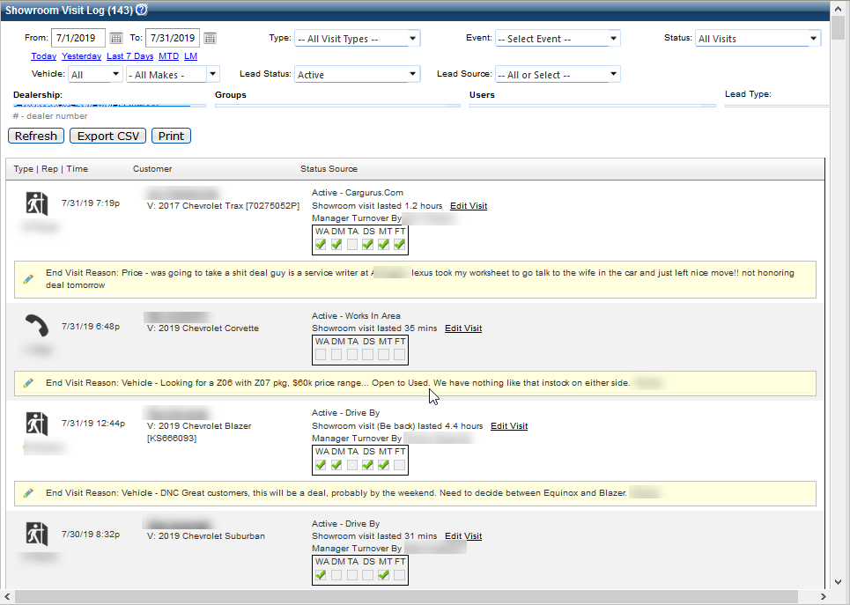
The Ultimate Power Play (WIFM)
CRM > Dashboard > Showroom Visit Log (Prospecting)
Notes:
Earlier we talked about the importance of managing the showroom visit log.
A big reason for this is now that we have really good information collected we can now prospect the showroom visit log when we need to pick up deals.
There are 2 times of the month when we are looking for low hanging fruit opportunities
Q. The beginning of the month: Why? What typically changes?
Incentives, customer who where not closeable might very well be in a situation with a new incentive that is now available (that wasn’t)
Q. The End of the month: Why?
We are looking to close out strong and add as many deals to the table as we can.
Recommendations:
End of the month Prospecting:
Search for the visits that happened in the first 3 weeks of the current month
Search for all visits that are still Active
The better your notes and Road to the sale are the better you will be positioned to take action on these still active visits.
Beginning of the month Prospecting:
Search for the visits that happened Last Month
Search for all visits that are still Active
The better your notes and Road to the sale are the better you will be positioned to take action on these still active visits.

Slide 37
Conclusion

Slide 38
Who are they talking to?
Why should I spend time on this?
Connect is a CRM tool
CRM stands for Customer Relationship Management
Who is communicating with your potential customers
You?
Your Competition?
If you are not providing the desired experience then rest assured your competition is !!!

Slide 39
Keys to Success Overview
Manager’s Keys To Success
1. Salespeople and Manager Tasks are completed
2. Appointments
3. Showroom Visits (Accurately & Timely)
4. Update Sold Log Every Night
5. DMS to CRM Sales/Customer Matching
6. Unanswered Emails and Text Messages
7. Active Leads without Future Follow Up - Sales
Sales Person’s Keys To Success
Enter 100% of customers into the CRM
Complete all your tasks
Review and complete alerts on your dashboard
Set your Appointments in the CRM
Log Showroom Visits for ALL customers!
Prospect in your Leads Page
Utilize your Wishlist

Slide 40
Q&A

